Slide 1

SA3 Final Project
Milestone 1: MVP

Slide 2
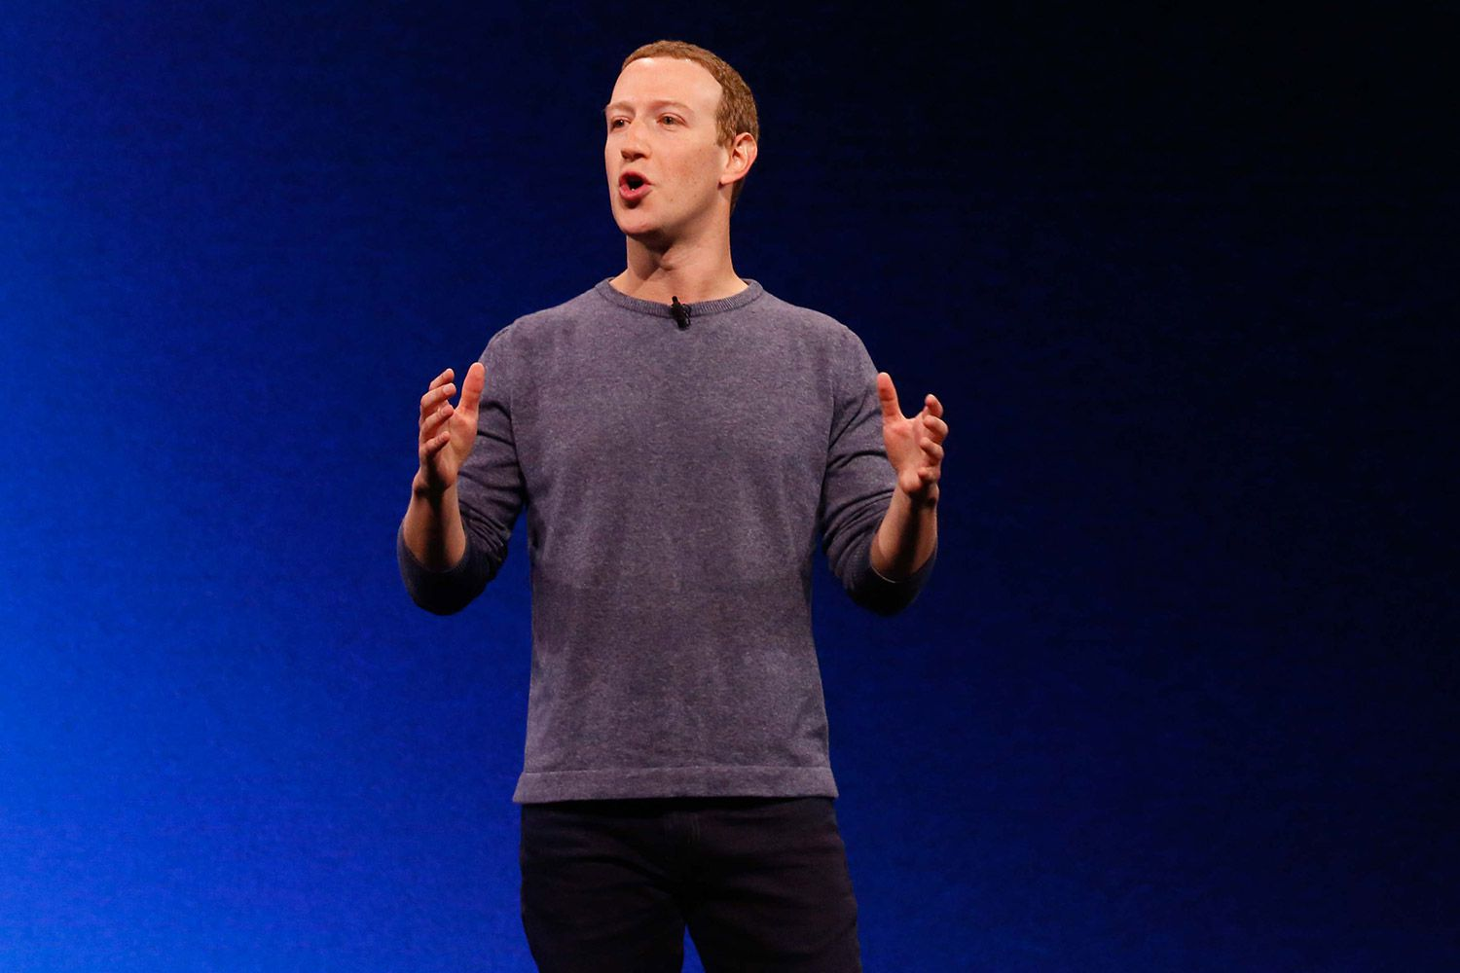

Your data

Slide 3



Slide 4
Q: How does account self-destruction work?
If you stop using Telegram and don't come online for at least six months, your account will be deleted.
https://telegram.org/faq

Slide 5

HandShake

Slide 6
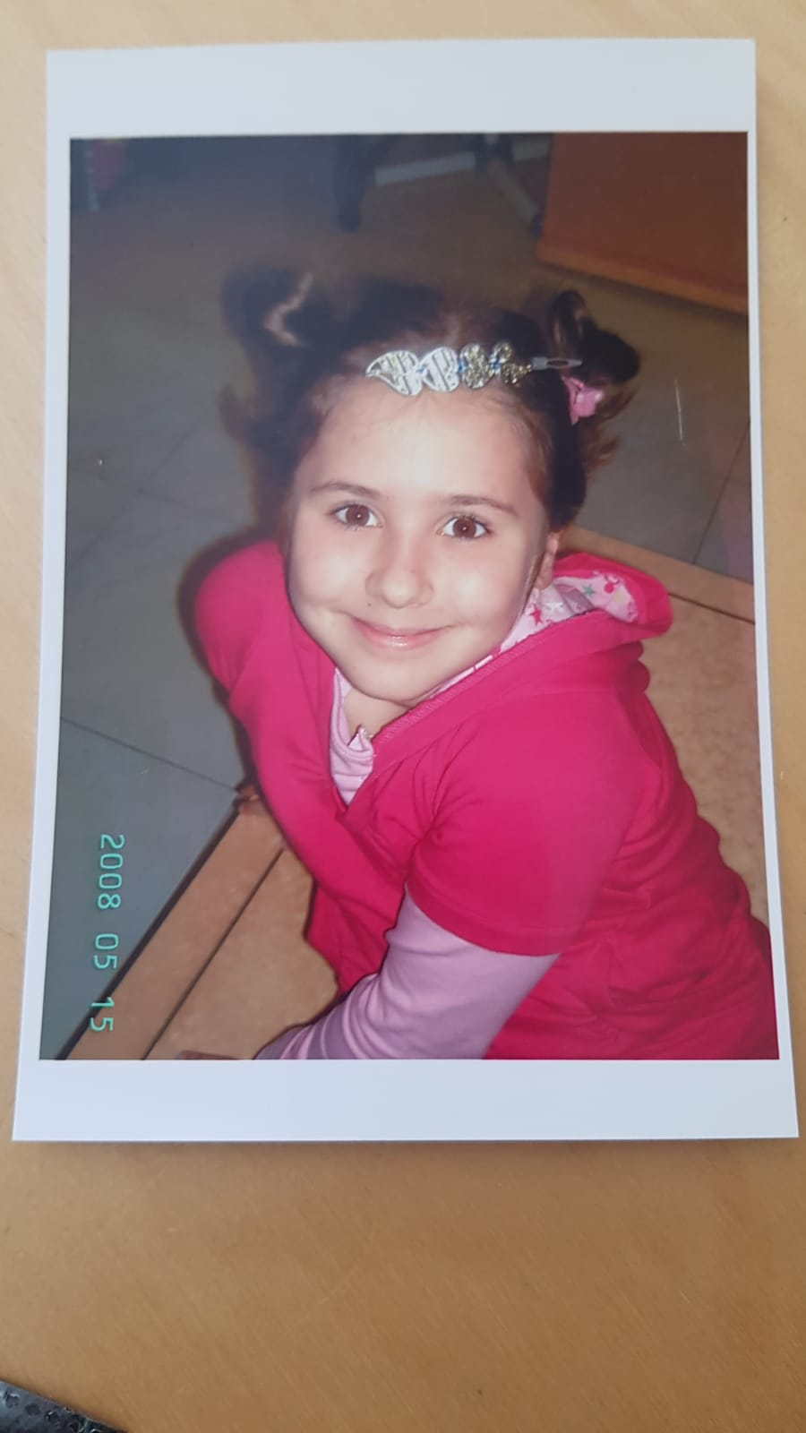
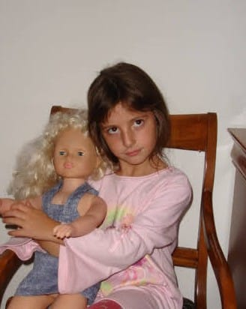
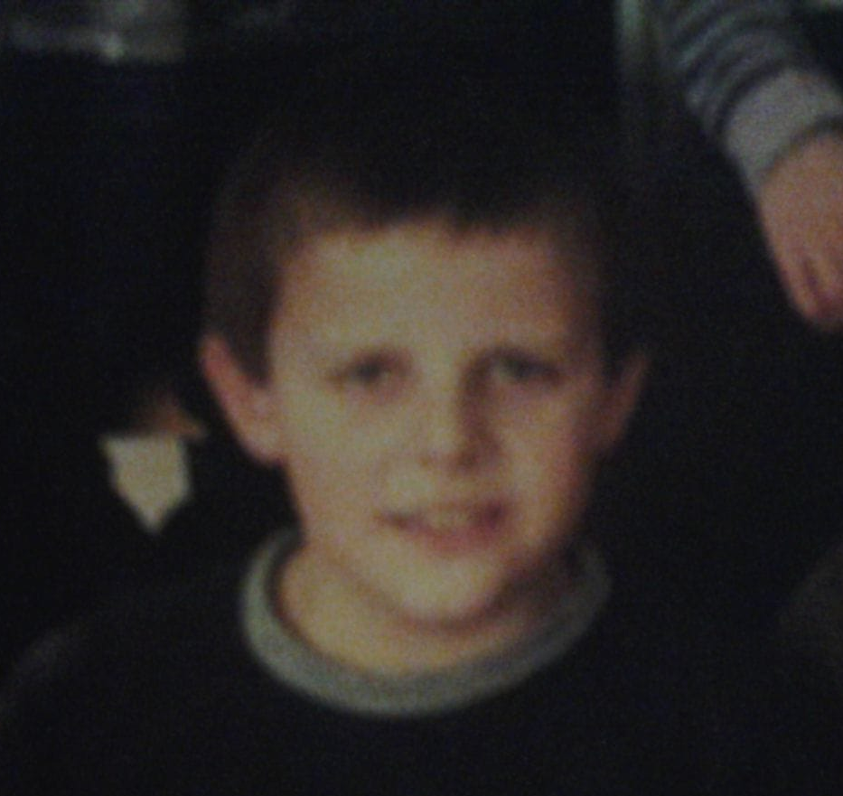
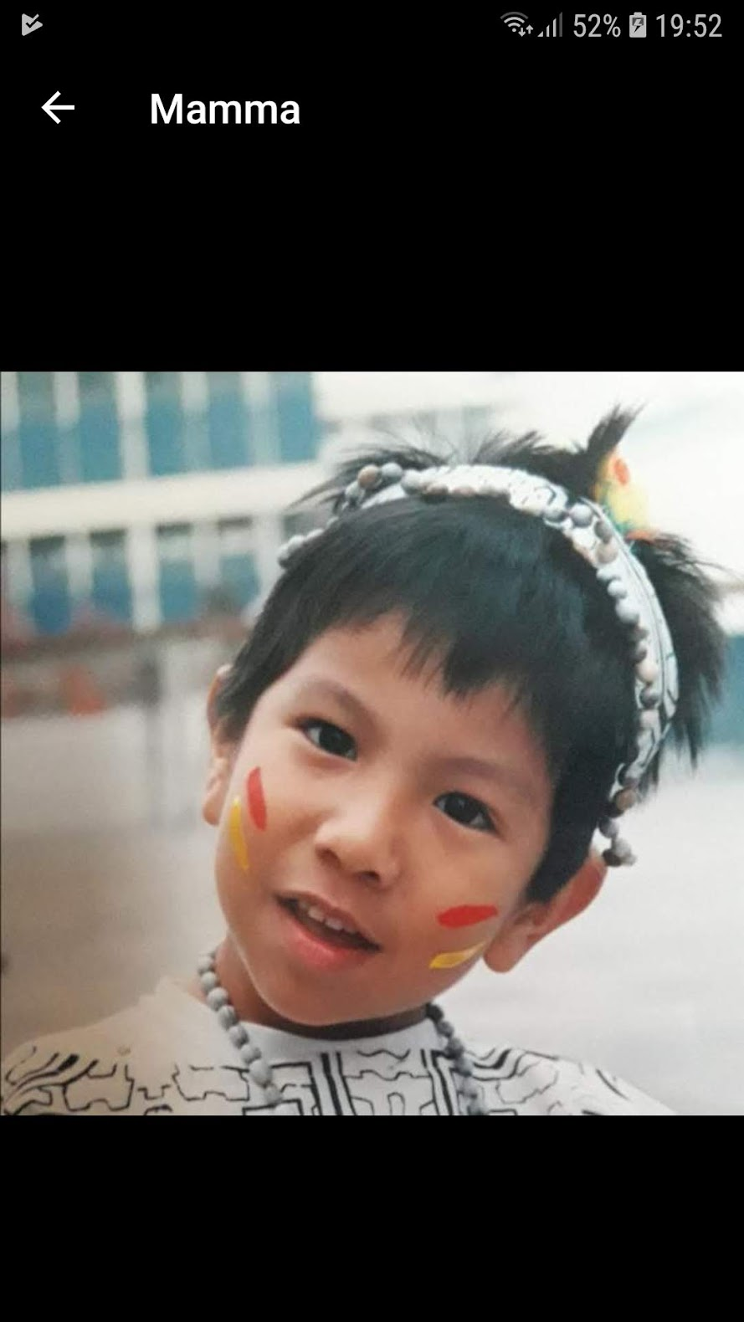
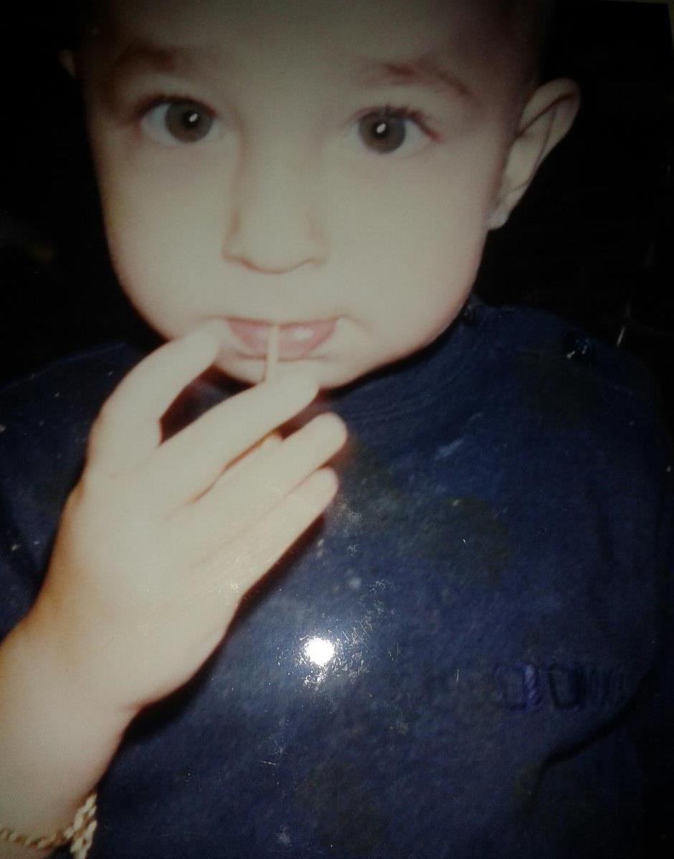
developed with ♡ by the OGs @ USI
d’Atri Sofia
De Filippo Loredana
Dalle Rive Michele
Jeferson
Tafta Nicolò

Slide 7

developed with ♡ by the OGs @ USI
@cosmcif
@DonnaDona
@micheledallerive
@JekxDevil
@Hwid2121

Slide 8

the plan
Notes:
so we did quite a lot of planning

Slide 9
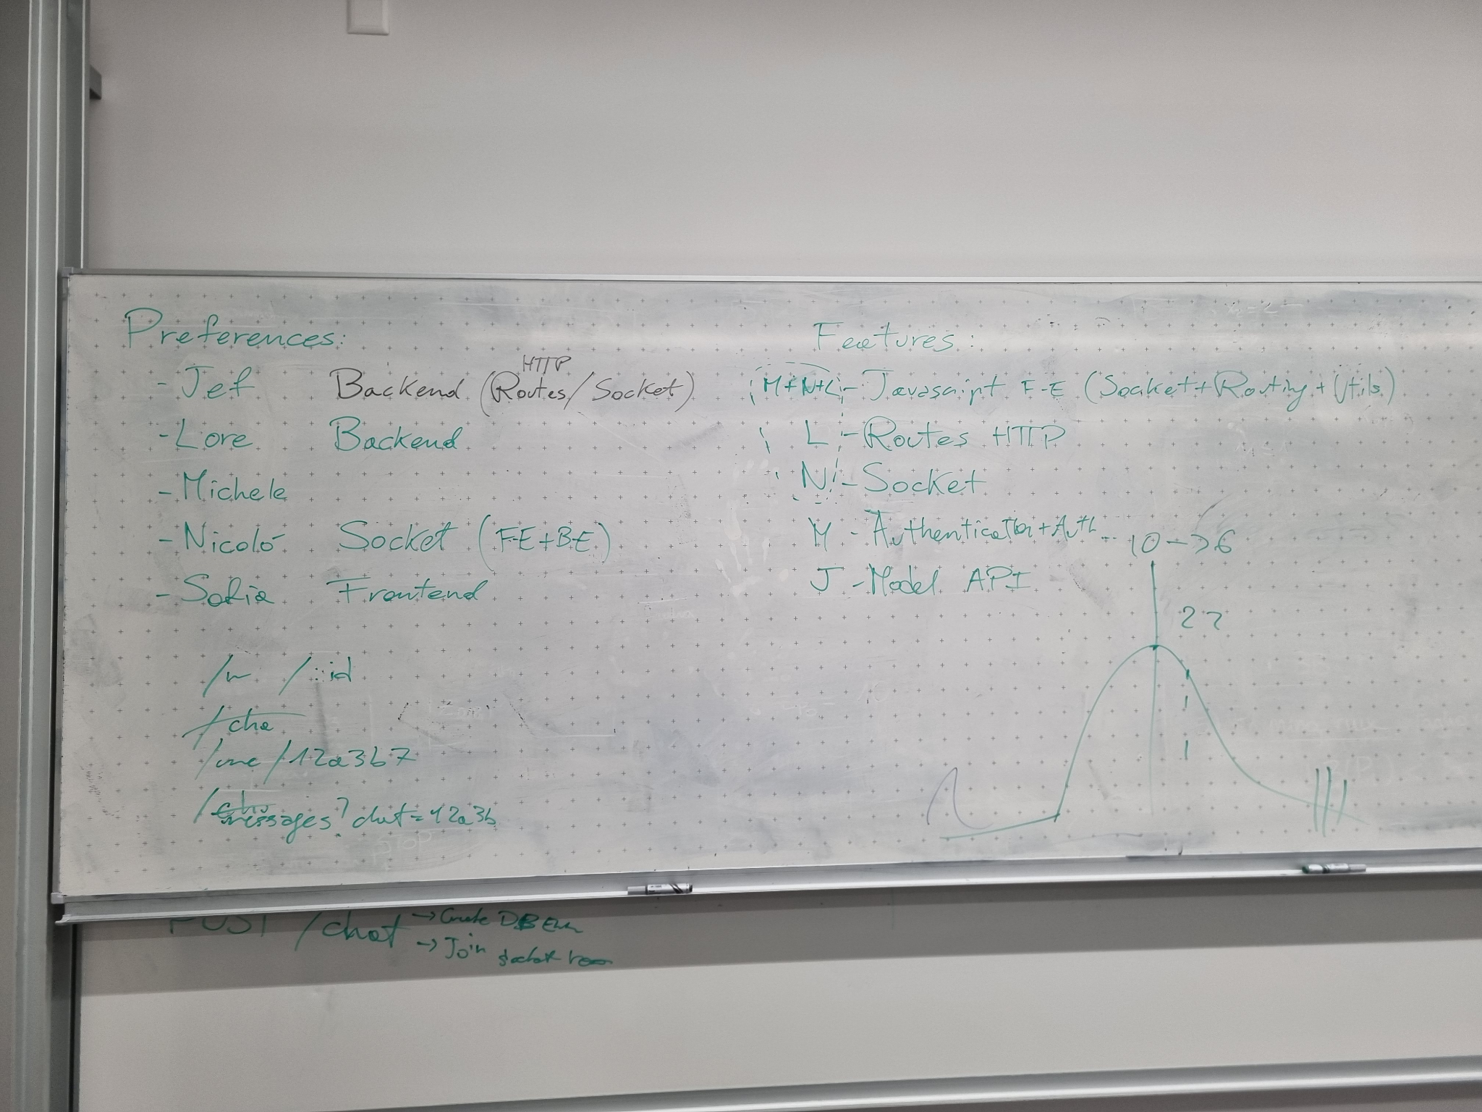
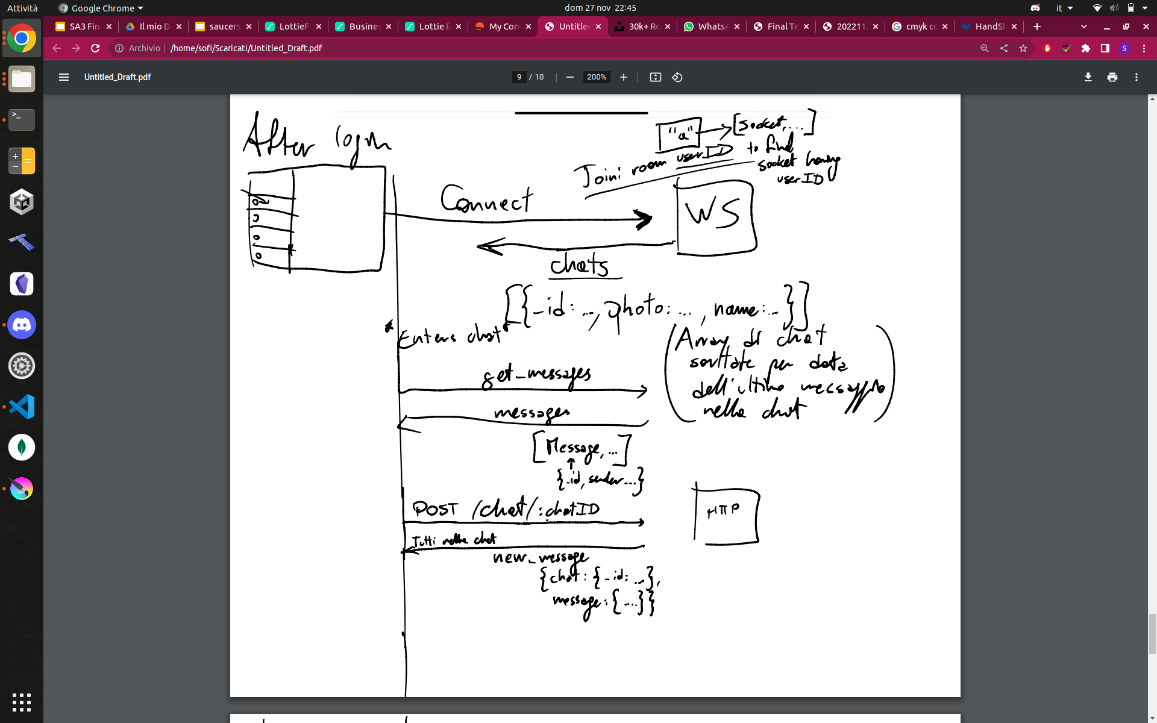
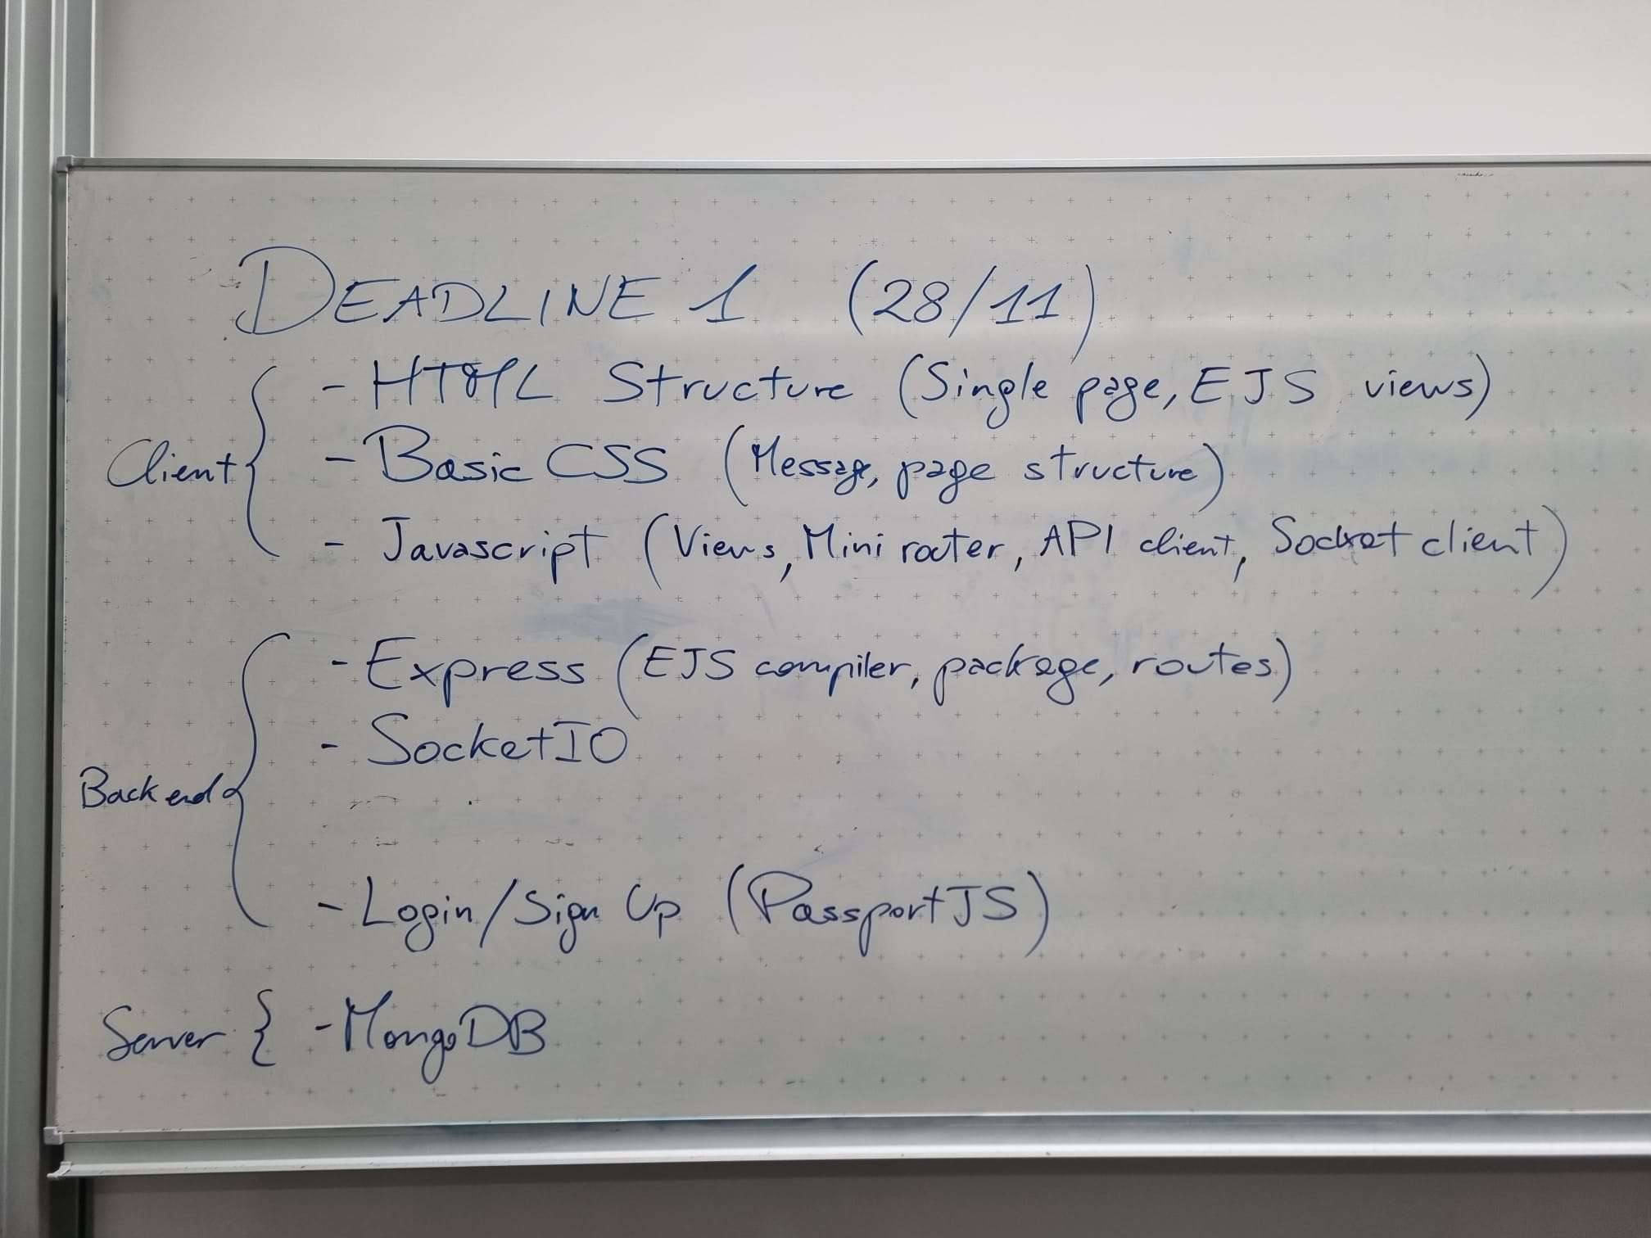
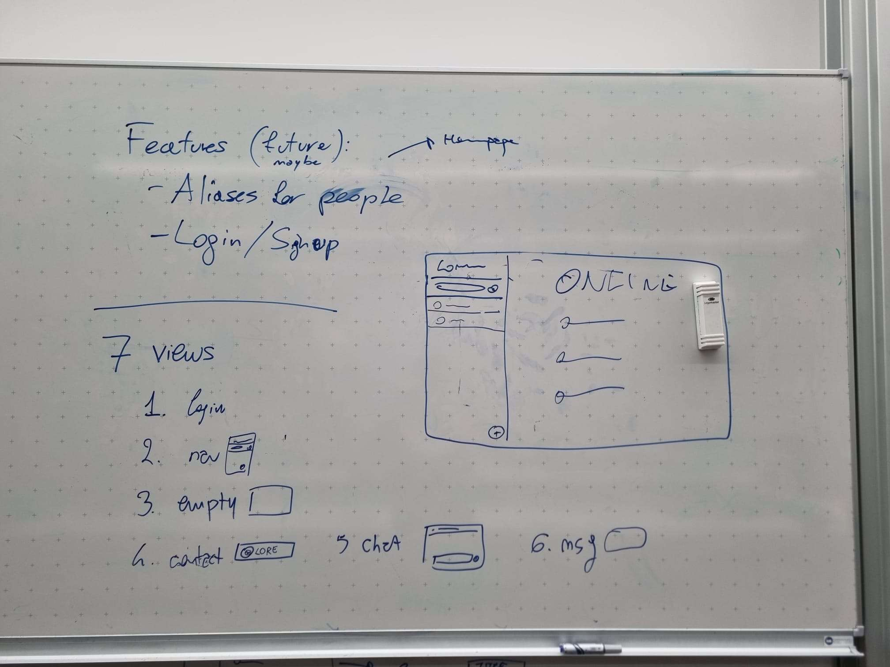
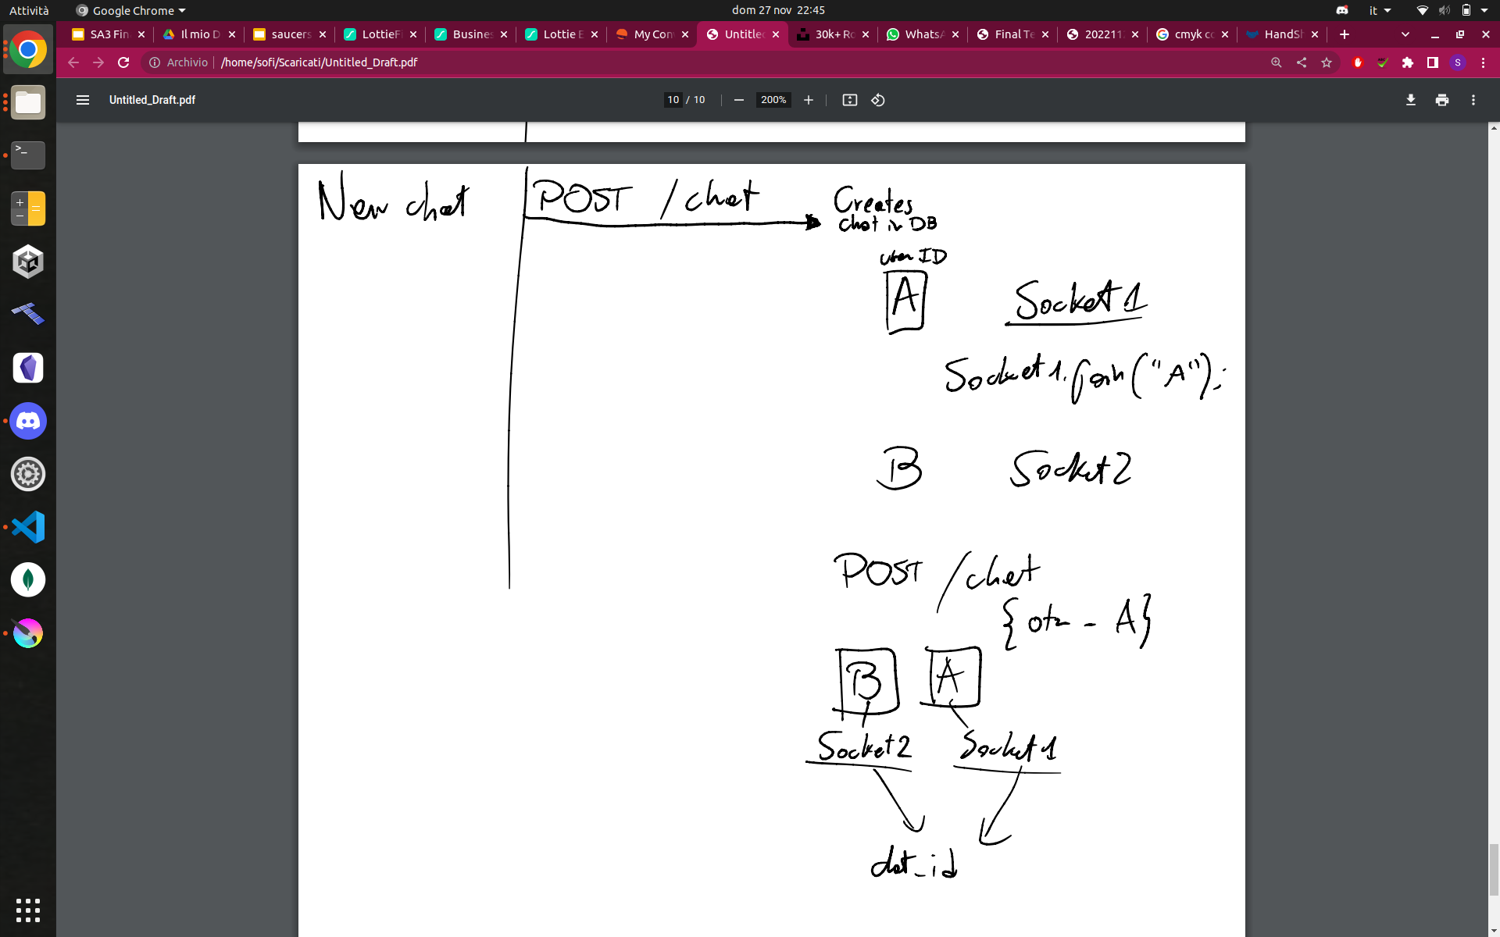
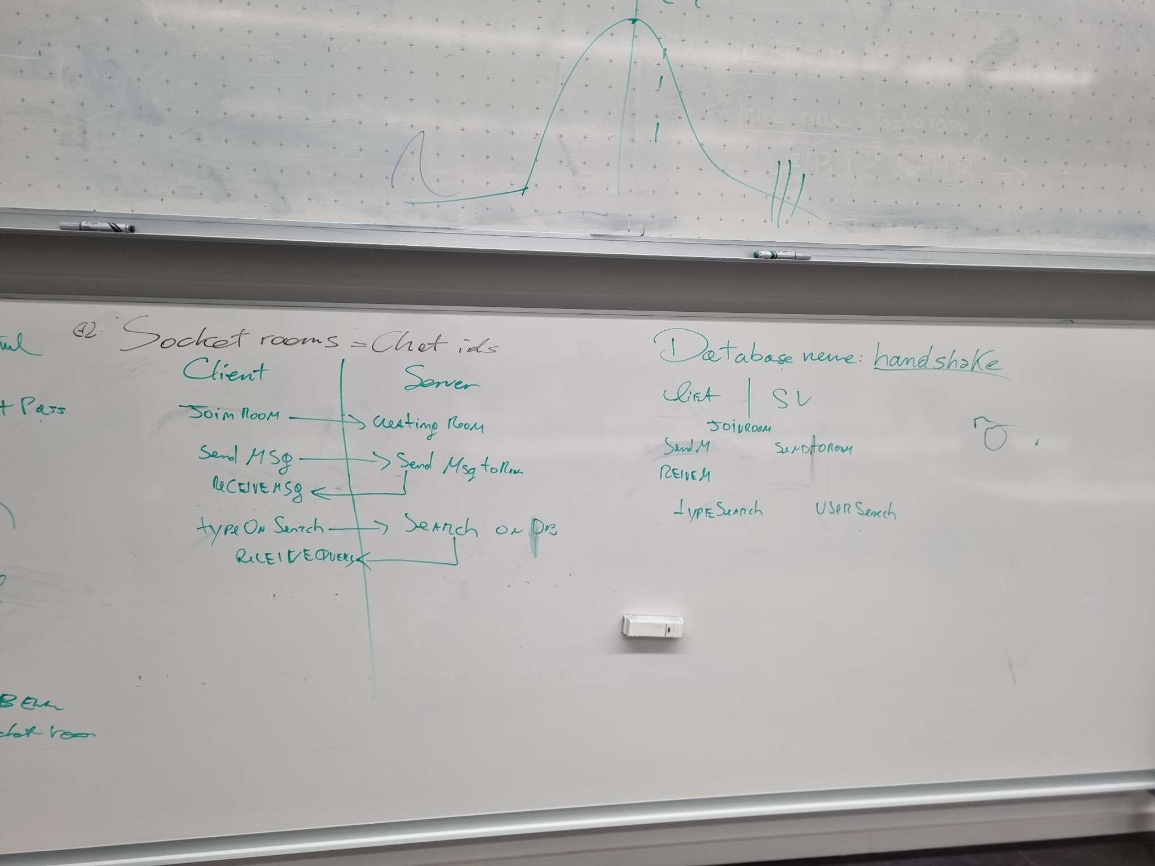
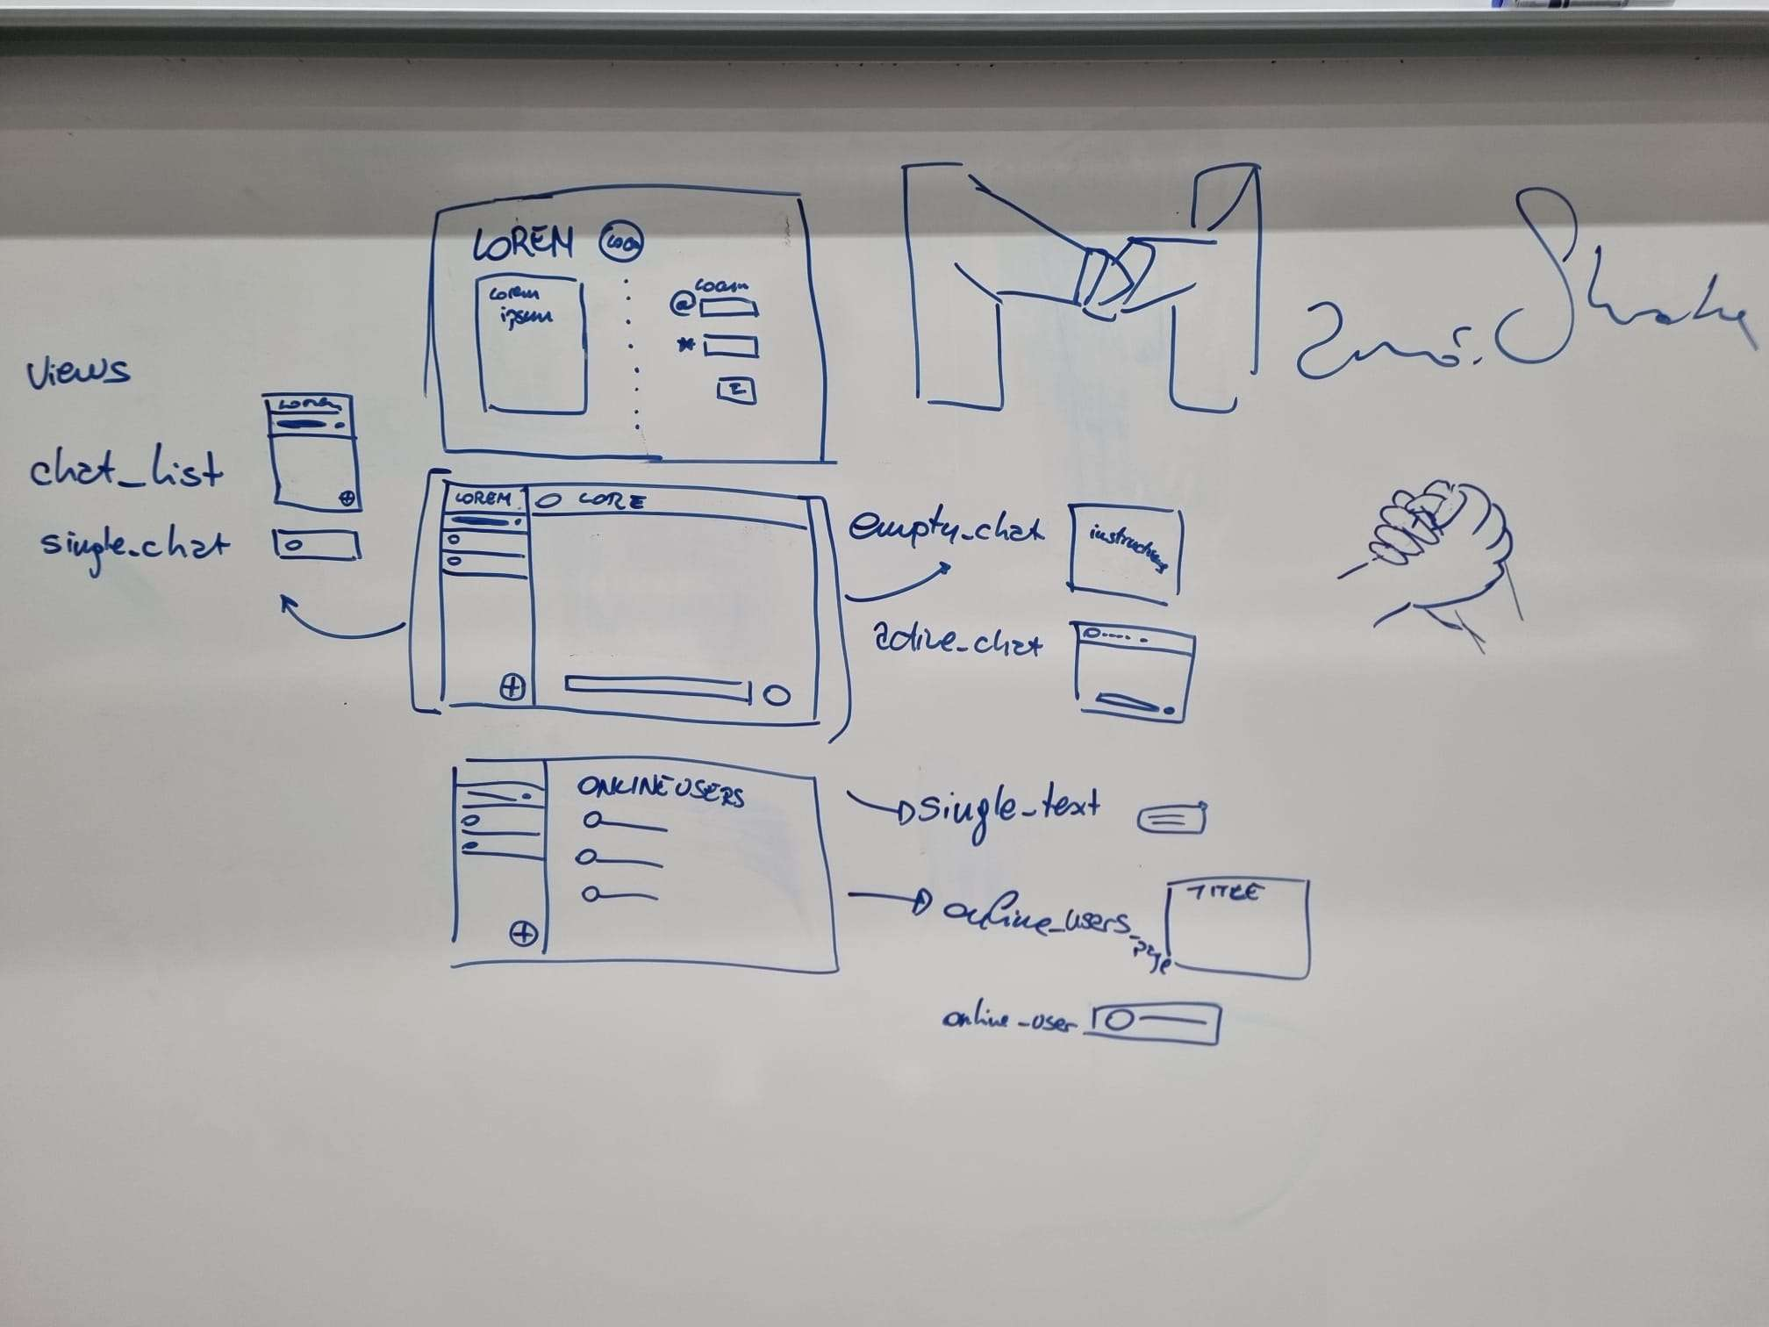
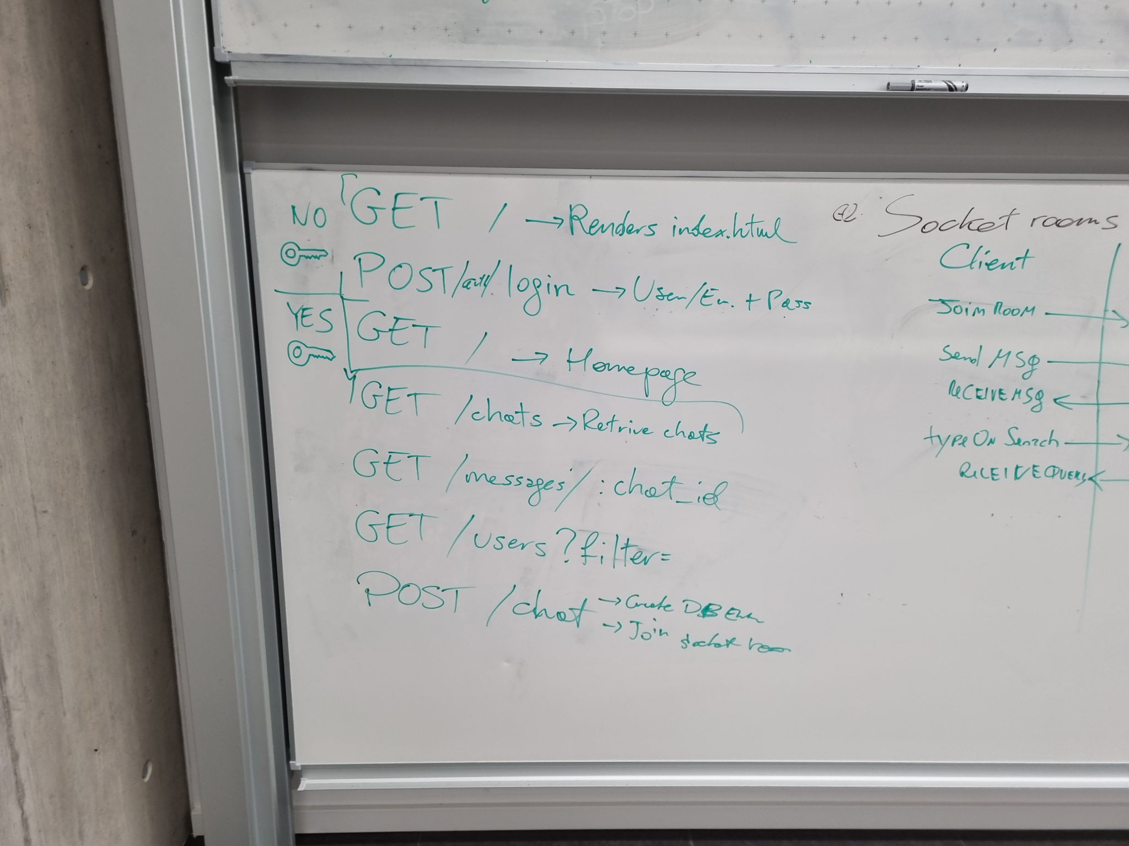
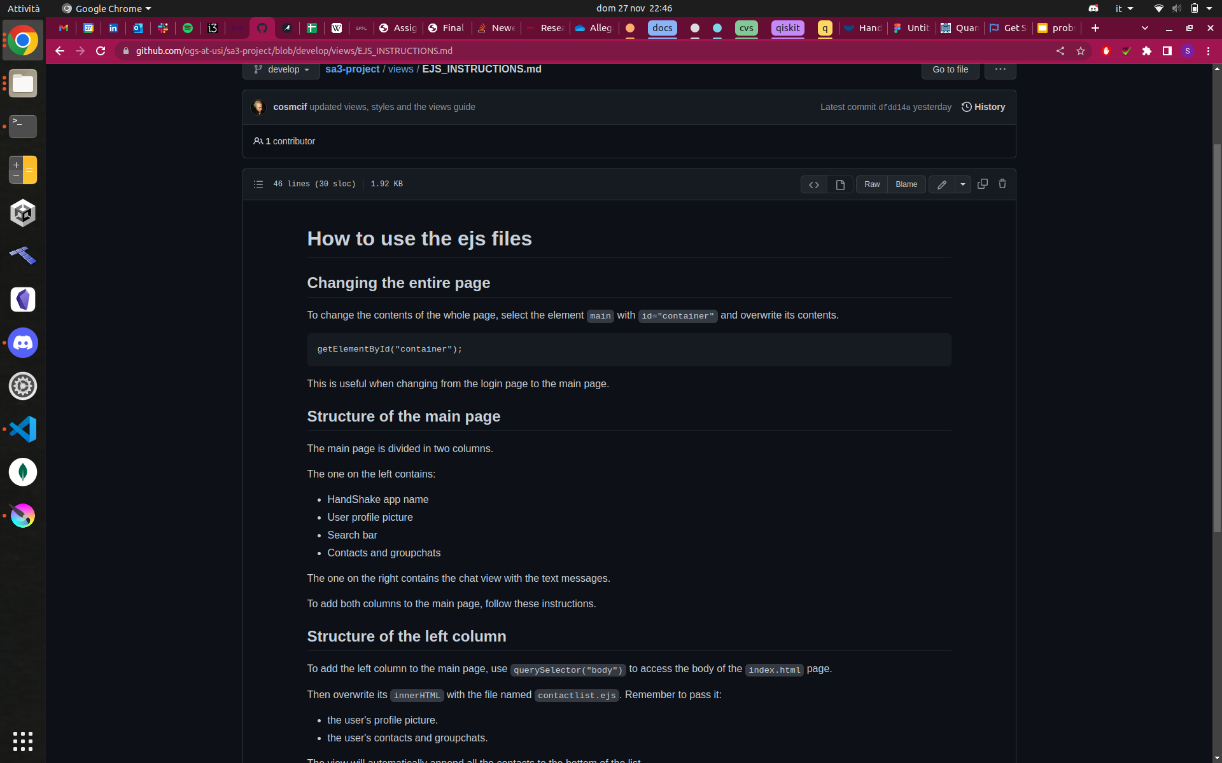
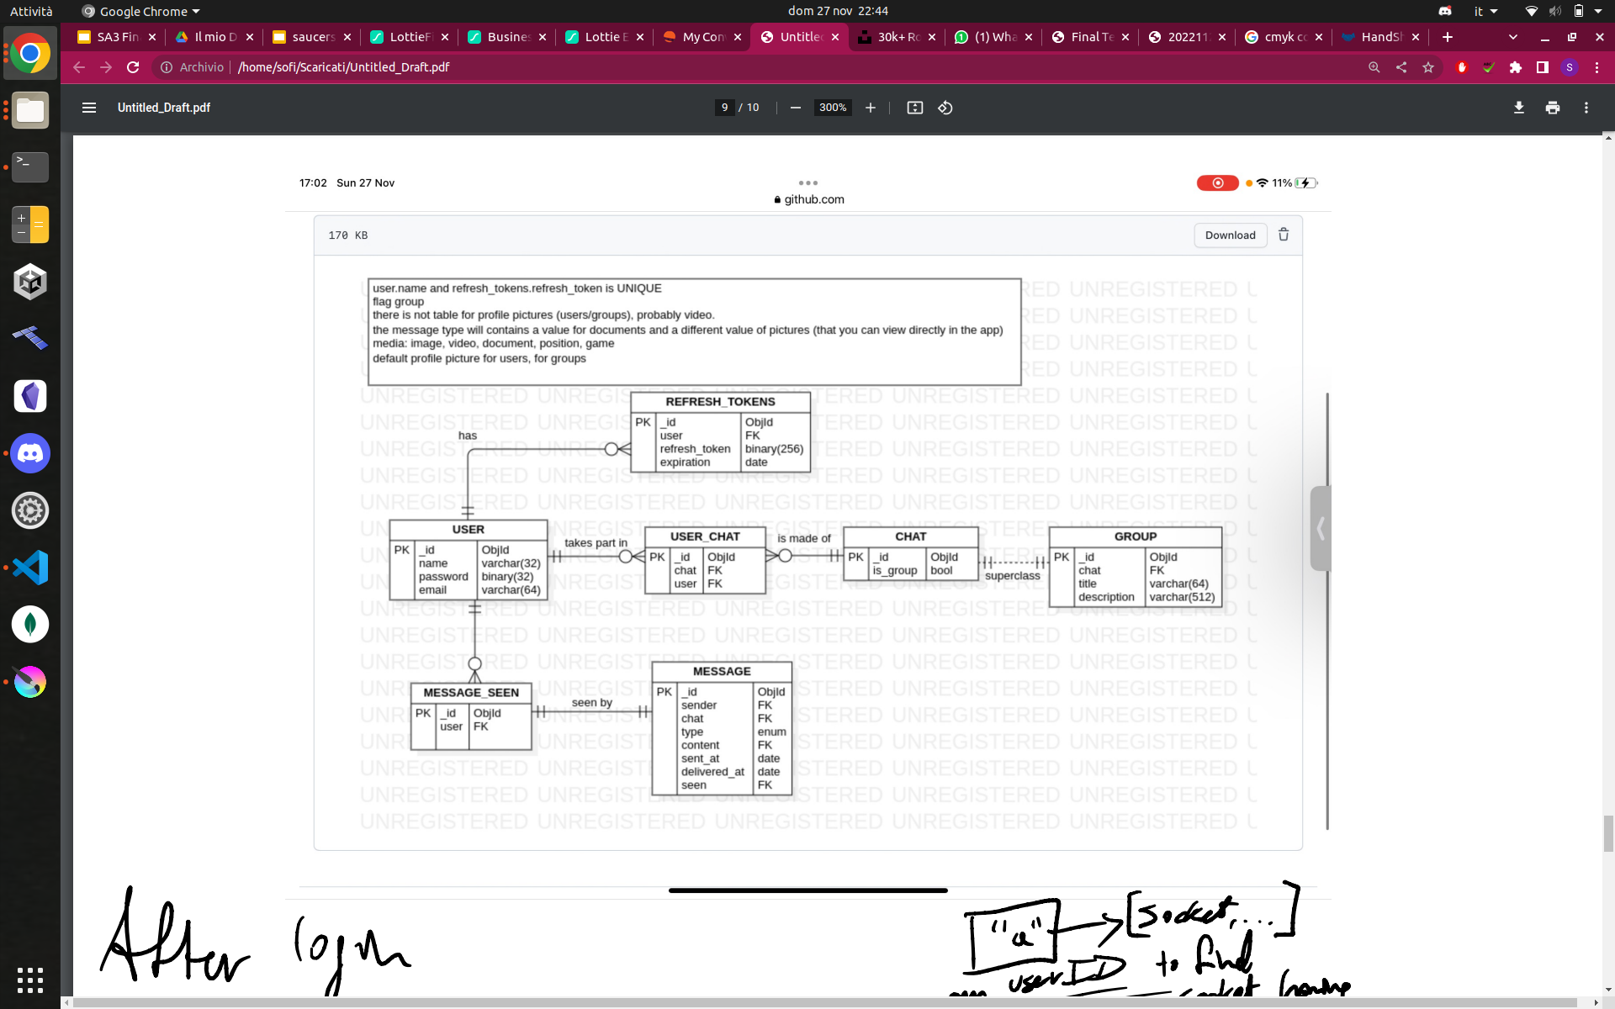
Notes:
and i mean a lot

Slide 10
Goals for this milestone

Slide 11
Goals for this milestone
Organize our team, our repo and our project

Slide 12
Goals for this milestone
Organize our team, our repo and our project
Plan the development for a MVP

Slide 13
Goals for this milestone
Organize our team, our repo and our project
Plan the development for a MVP
Layout / views ready

Slide 14
Goals for this milestone
Organize our team, our repo and our project
Plan the development for a MVP
Layout / views ready
Set up the database

Slide 15
Goals for this milestone
Organize our team, our repo and our project
Plan the development for a MVP
Layout / views ready
Set up the database
Set up the routes

Slide 16
Goals for this milestone
Organize our team, our repo and our project
Plan the development for a MVP
Layout / views ready
Set up the database
Set up the routes
Set up the authentication system

Slide 17
Goals for this milestone
Organize our team, our repo and our project
Plan the development for a MVP
Layout / views ready
Set up the database
Set up the routes
Set up the authentication system
Choose the roles

Slide 18
Roles
Front end / layout
Routes
Authentication / project manager
Database / back end wizard
Socket / customer

Slide 19
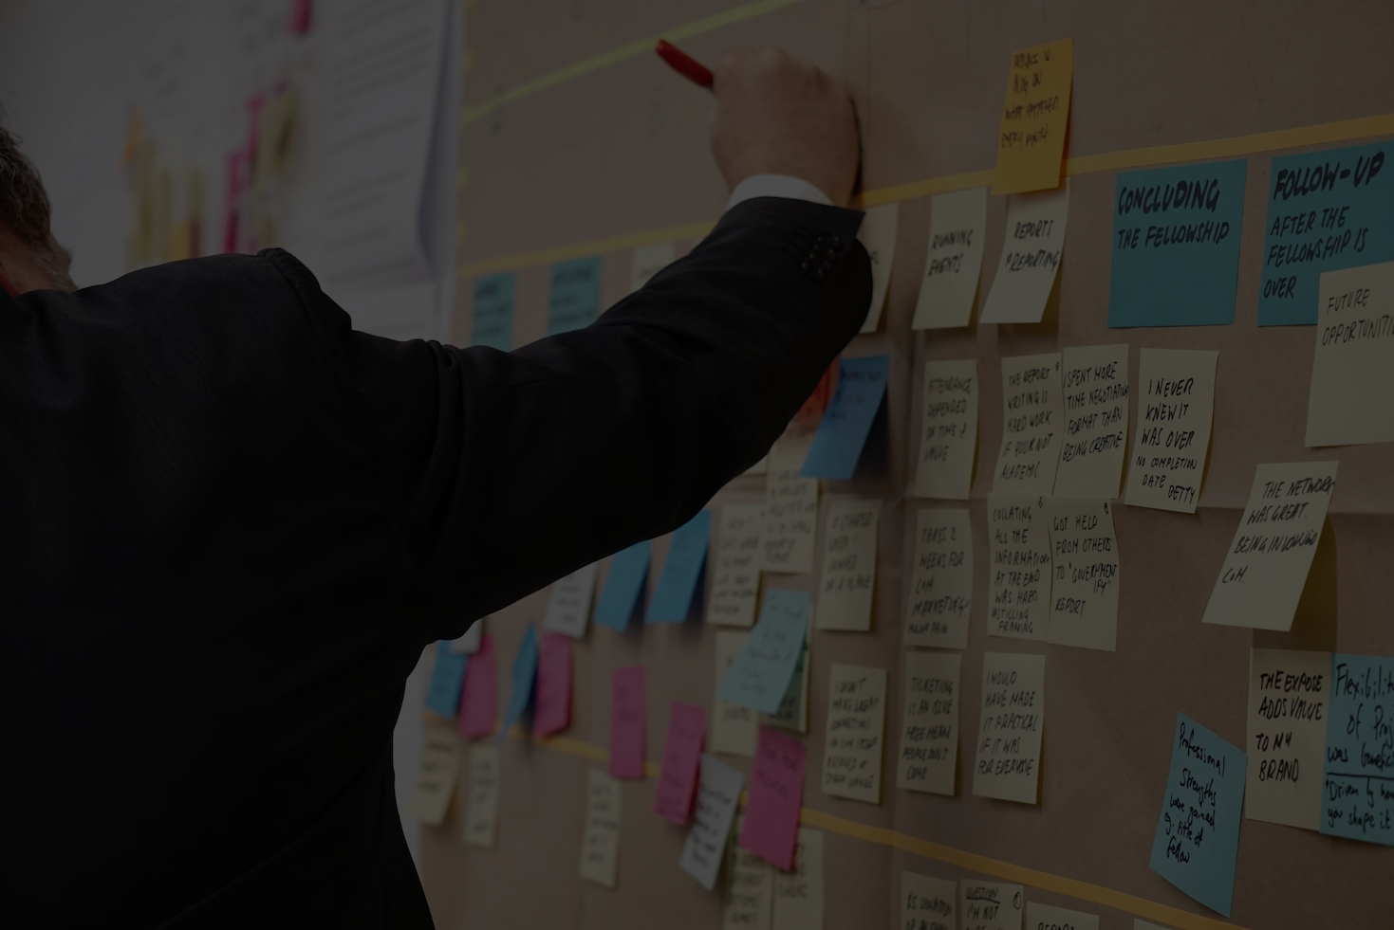
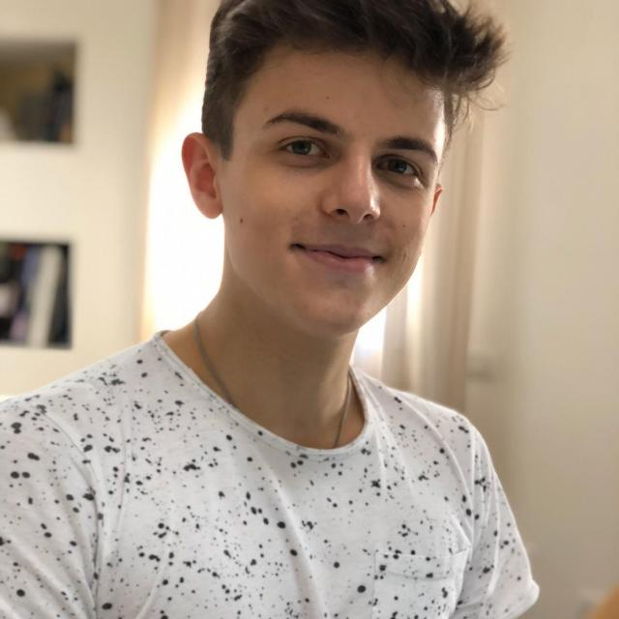

project manager

Slide 20
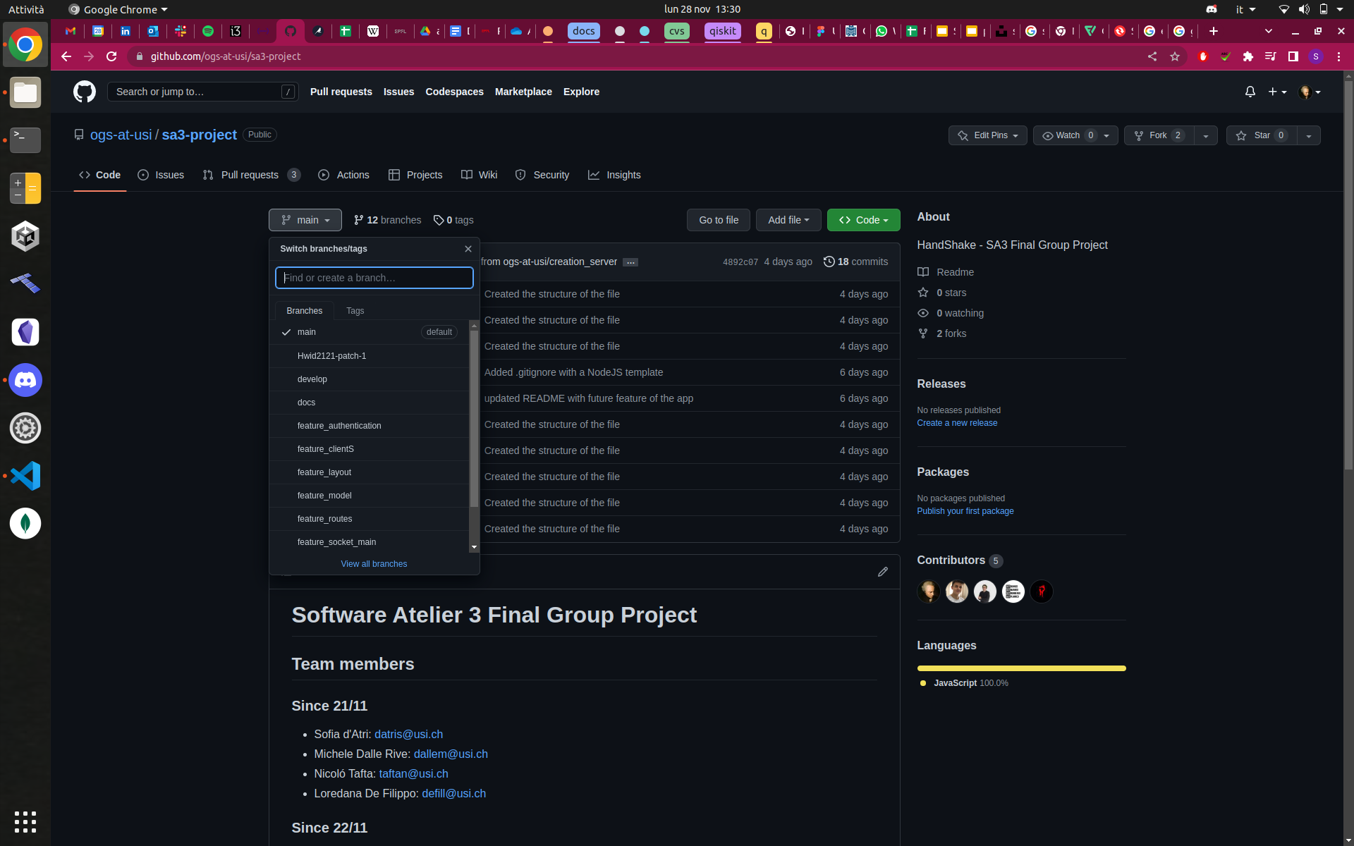


milestone releases
keeps track of development

Slide 21



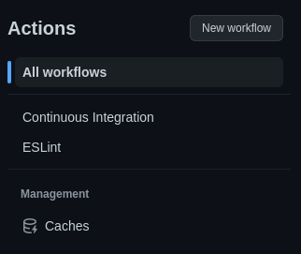

Tools

Slide 22
Actions
Consistent code style
Spot errors early

Slide 23
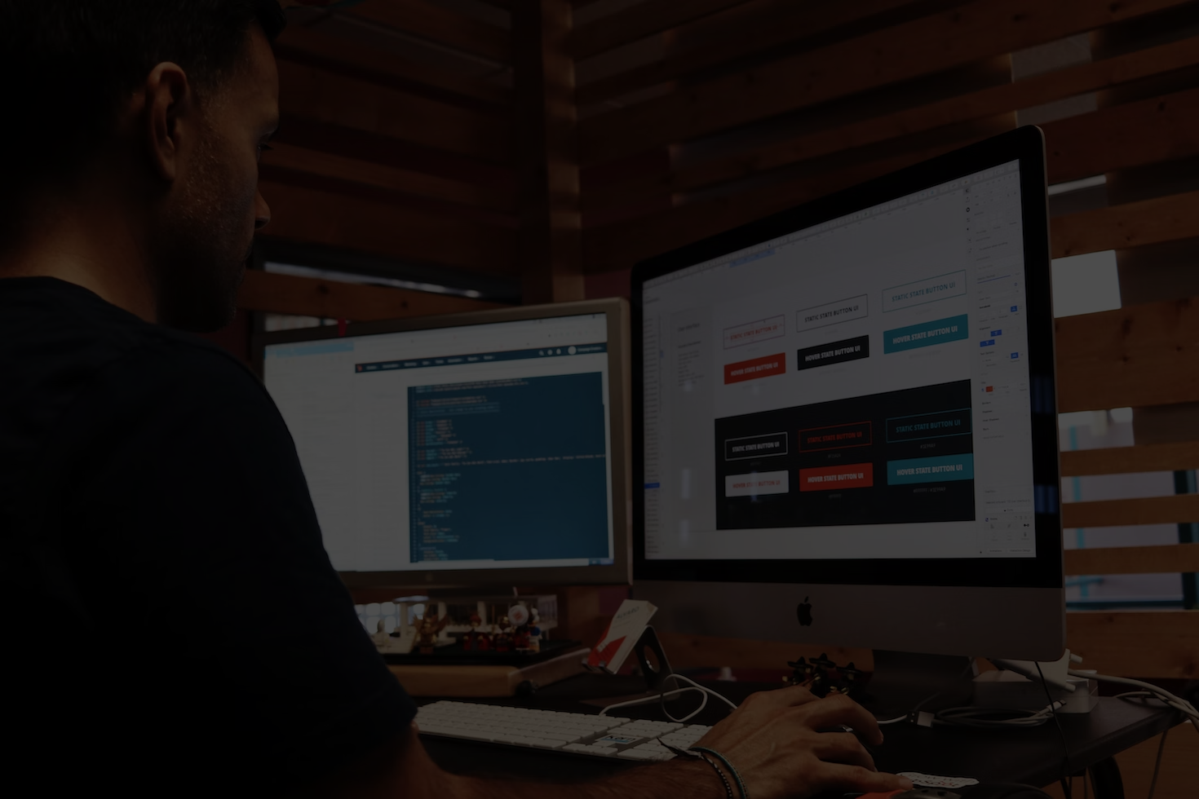
frontend
Notes:
first of all, we had to decide, what should the website look like

Slide 24
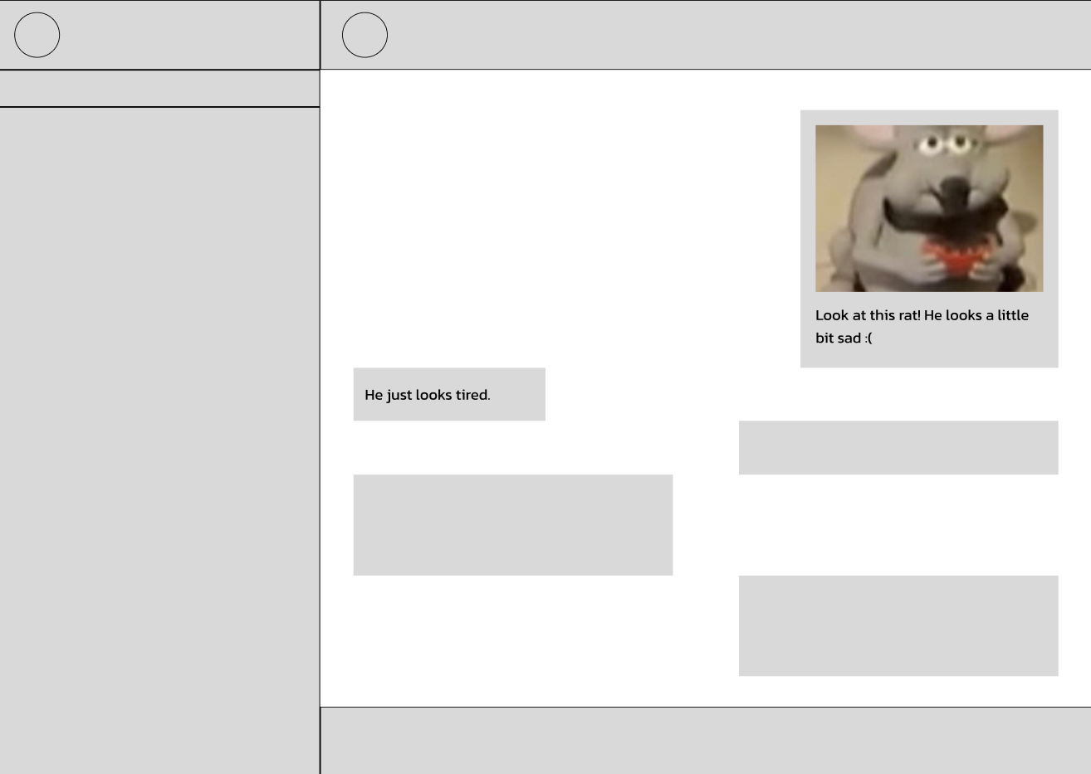
Notes:
so we made a quick sketch in figma. then it was time to pick the colors

Slide 25
Notes:
like good designers we got our color wheel out

Slide 26
Notes:
carefully handpicked four colors

Slide 27
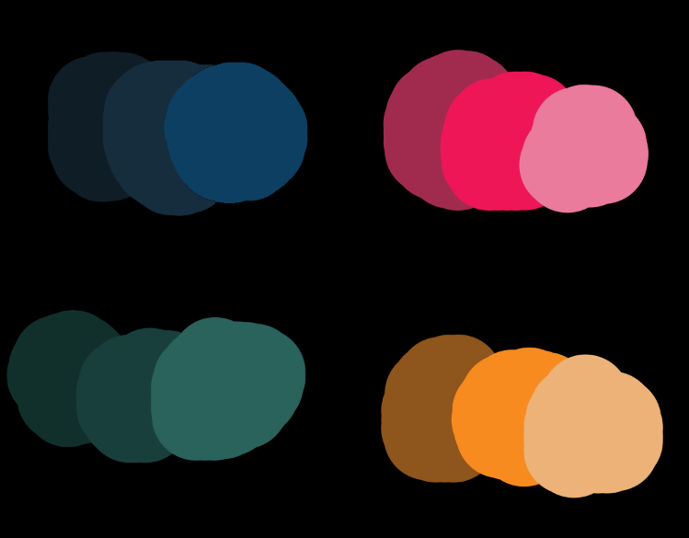
Notes:
chose the right shades, and

Slide 28
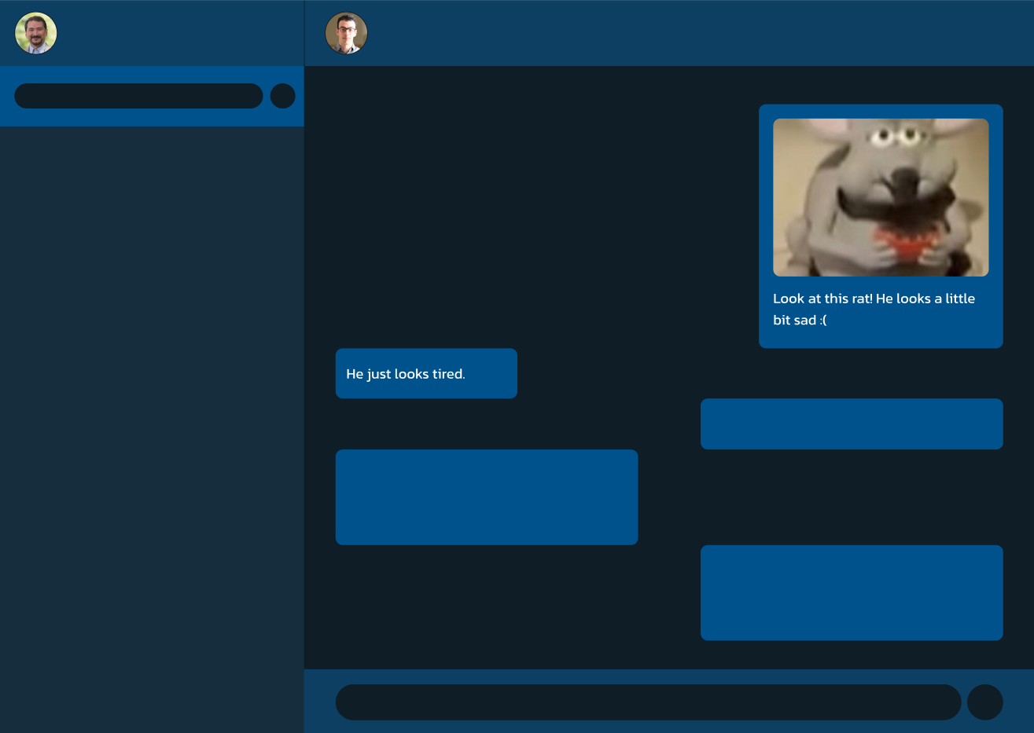
Notes:
we ended up with the most basic “chat messaging app blue” we could have chosen
but that’s okay, because one of the features of our amazing website will be

Slide 29

themes
(to be added sometime in the future)
Notes:
Themes! customize the app and make it unique

Slide 31
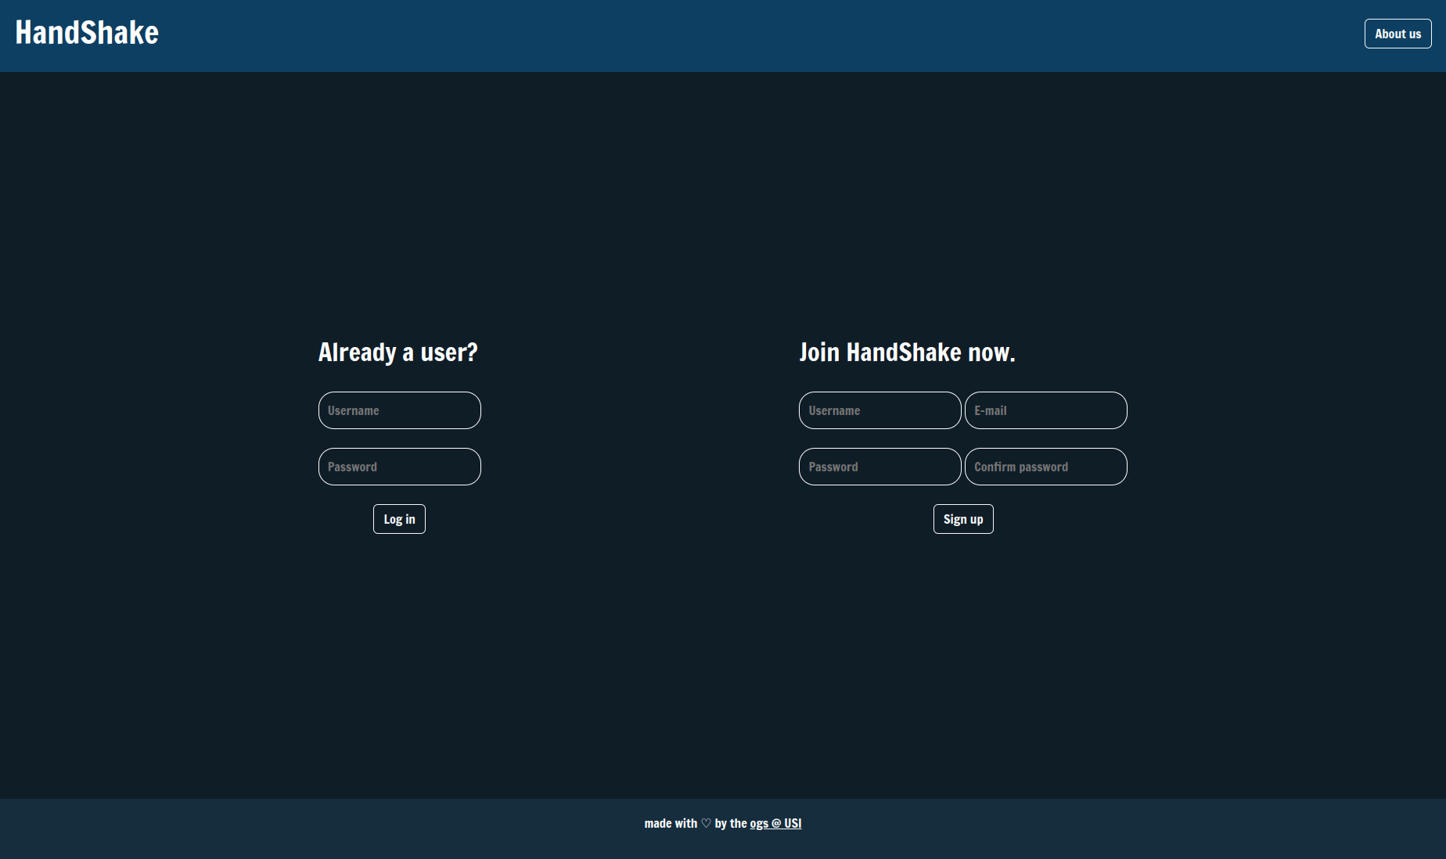

Slide 32
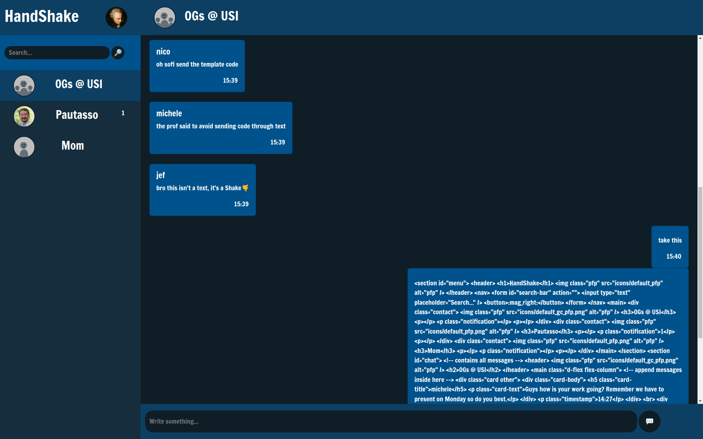

Slide 33
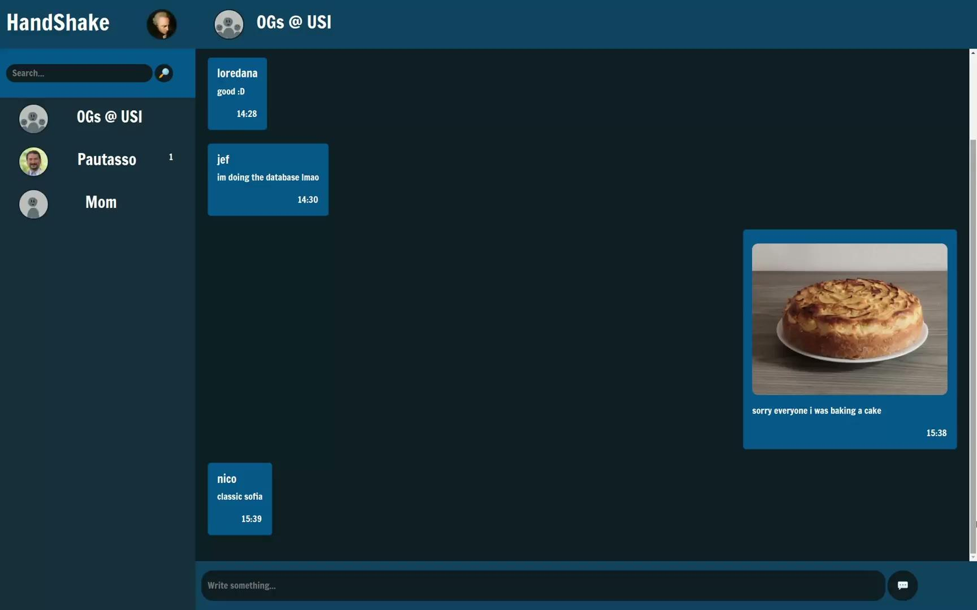

Slide 34
Michele
Backend + Planning
Authentication
1. Planned with the team the project organization (work in progress)
2. Organized the github repository and the project tools, with CI and code quality checks.
3. Implemented an authentication and authorization system with JWT and refresh tokens.
Loredana
Backend
Routes
Create and handle the routes
1. Decided the route structure with the team.
2. Implemented the server routes.
3. Interacted with the database using Mongoose.
jeff
Backend + database:
- ER database schema to define entities and interaction in a entity-relation database
- conversion in a mongodb supported scheme for NOSQL document oriented database
- defining the api for the interaction of the backend and the records stored through classes and then ORM
- ORM Mongoose chosen to abstract database interaction with the collection, by defining entities as Models (through Schema entity declaration and definition with type support)
nico
Backend + Customer
1. Socket scheme (on working) for the next milestone.
2. Create and setting up the folder structure for the github repo.
3. Give feedback about frontend and about the backend solution and testing for issues.

Slide 35

backend

Slide 36
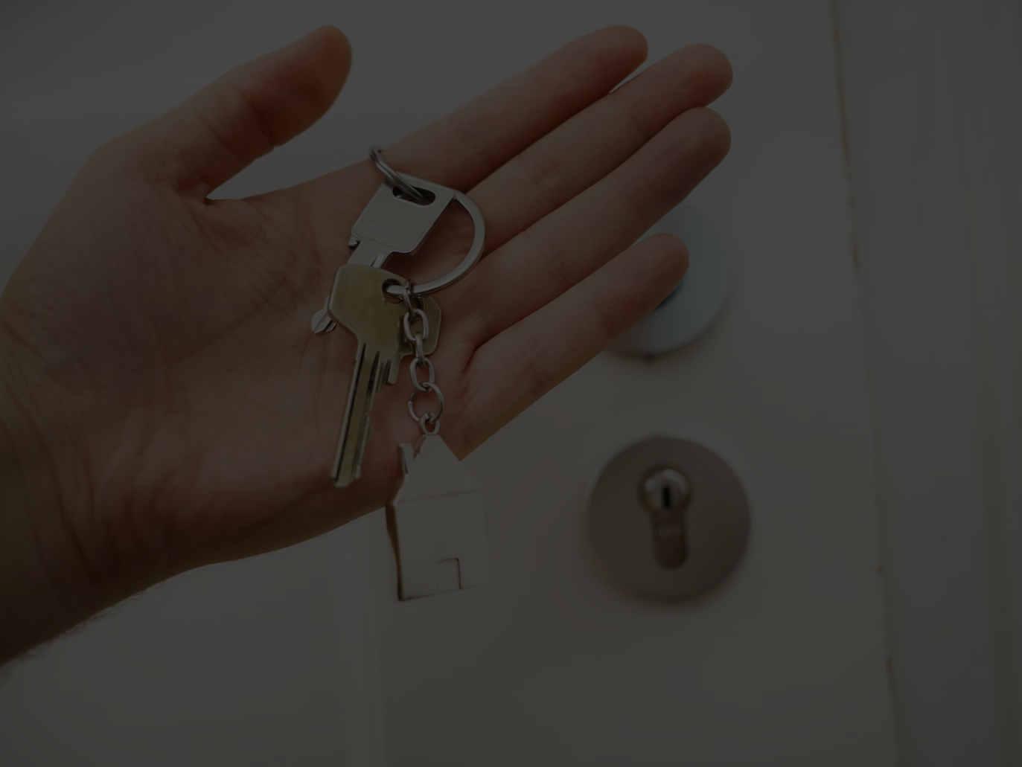
authentication

Slide 37
JWT
JSON Web Token
Access token is inaccessible by the client

Slide 38
JWT
JSON Web Token
Access token is inaccessible by the client
Short token lifespan -> high security

Slide 39
JWT
JSON Web Token
Access token is inaccessible by the client
Short token lifespan -> high security
Refreshed by refresh tokens

Slide 40
JWT
JSON Web Token
Access token is inaccessible by the client
Short token lifespan -> high security
Refreshed by refresh tokens
Routes protected by a validation middleware

Slide 41
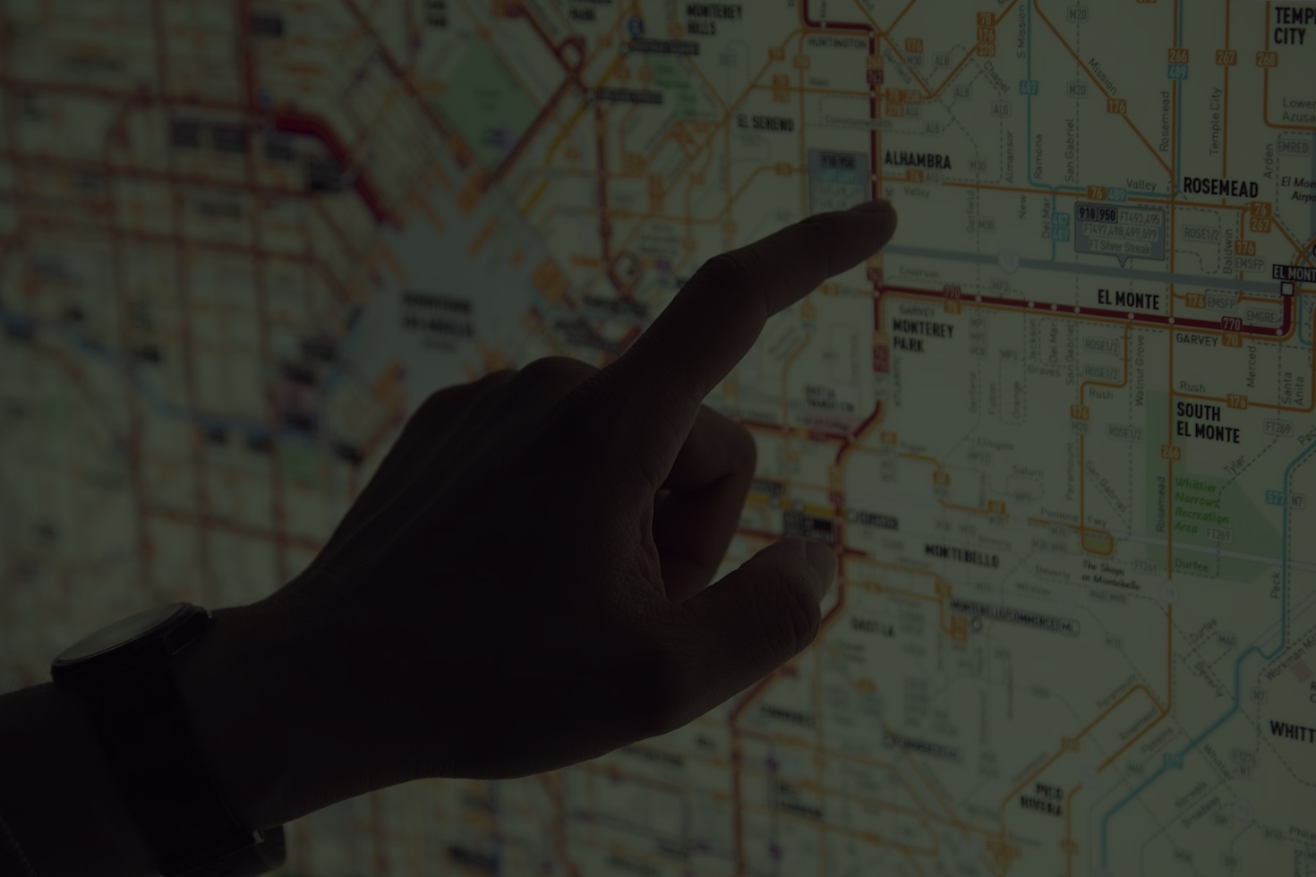
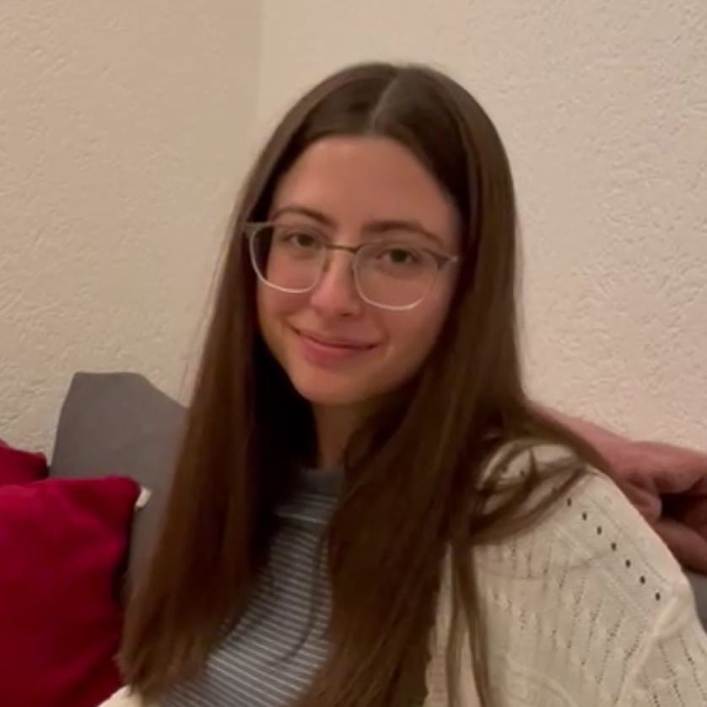
routes

Slide 42
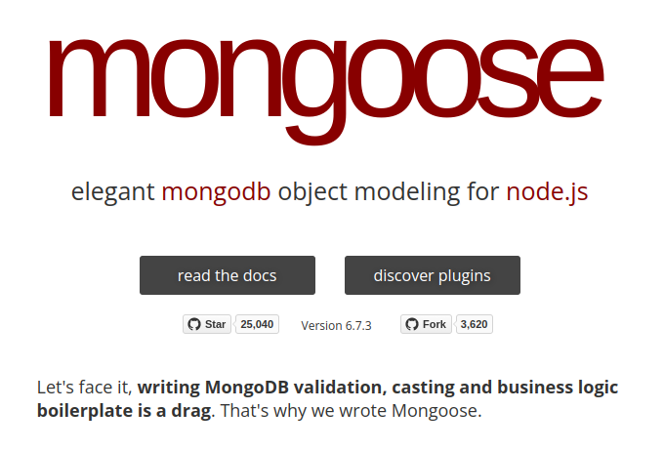

api
populate()

Slide 43
api
populate()

Slide 44
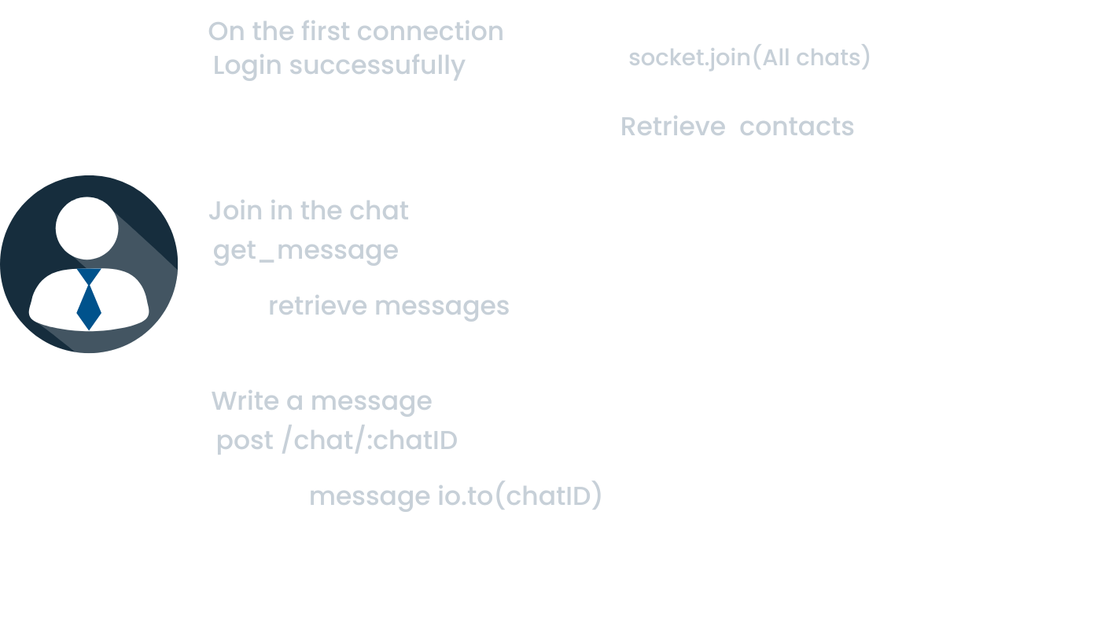
(more on this later)

Slide 45
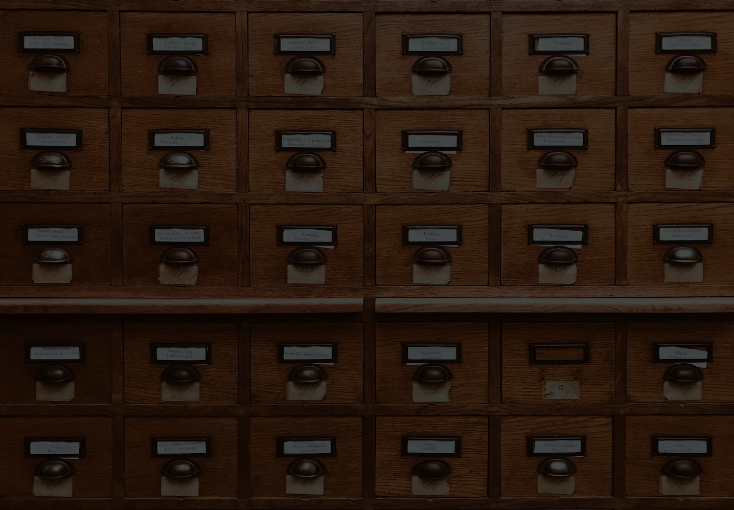
database

Slide 46
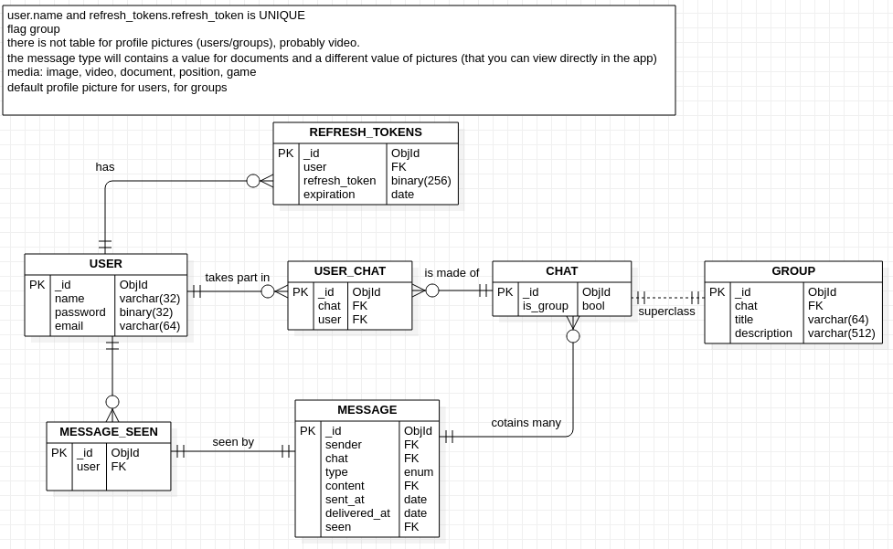
ER database scheme

Slide 47
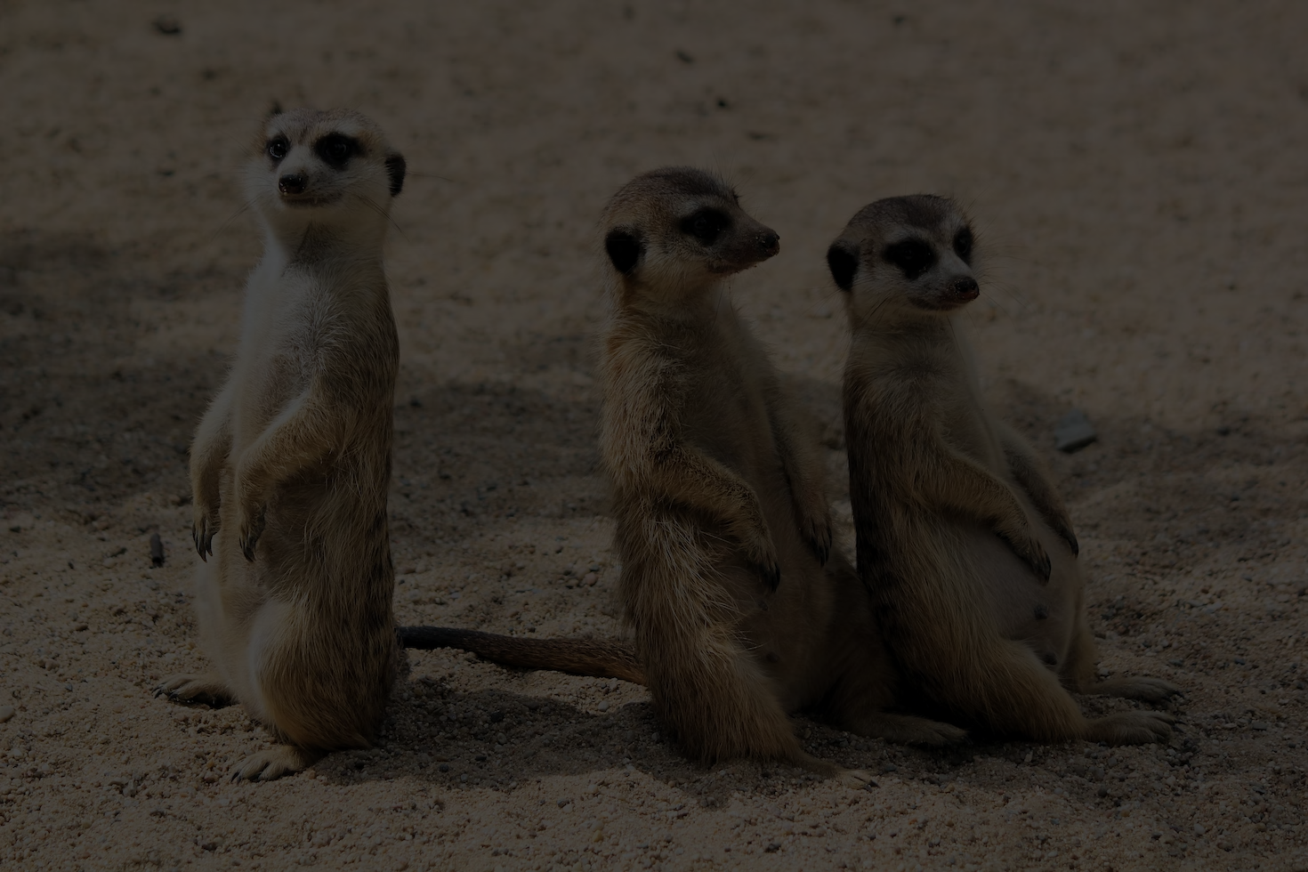
Mongoose,
from ORM to ODM, Schema and Models

Slide 48
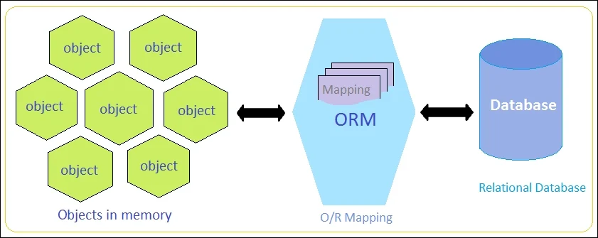


Slide 49

socket

Slide 50


Slide 52

what’s next?

Slide 53
Goals for this project
Send texts

Slide 54
Goals for this project
Send texts
Support image / video / audio files

Slide 55
Goals for this project
Send texts
Support image / video / audio files
Support position sharing

Slide 56
Goals for this project
Send texts
Support image / video / audio files
Support position sharing
Add in-chat games

Slide 57
Goals for this project
Send texts
Support image / video / audio files
Support position sharing
Add in-chat games
Support calls and video calls (big maybe)

Slide 58
Goals for this project
Send texts
Support image / video / audio files
Support position sharing
Add in-chat games
Support calls and video calls (big maybe)
Customization with predefined and user themes

Slide 59
Goals for this project
Send texts
Support image / video / audio files
Support position sharing
Add in-chat games
Support calls and video calls (big maybe)
Customization with predefined and user themes
Deployment

Slide 60
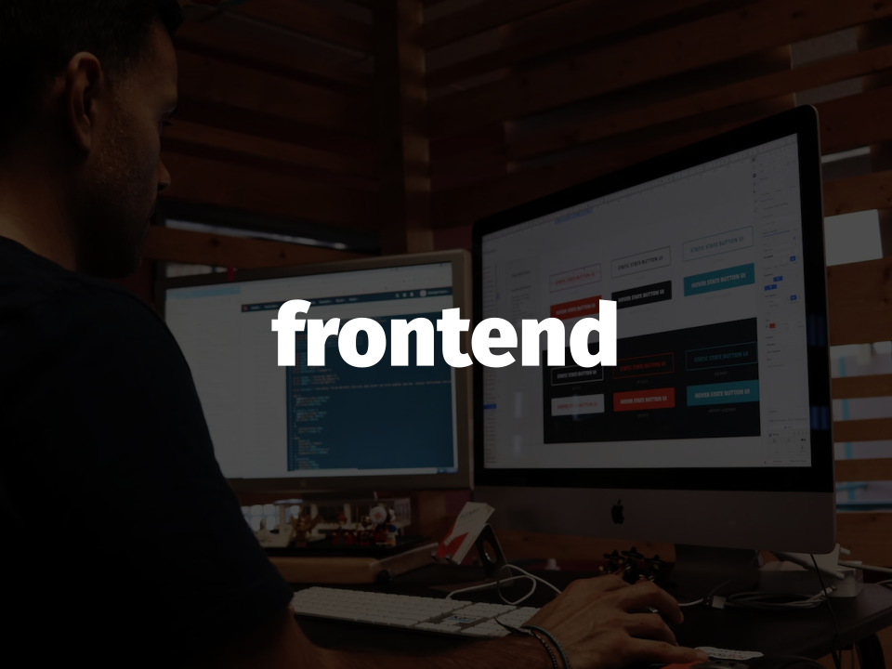
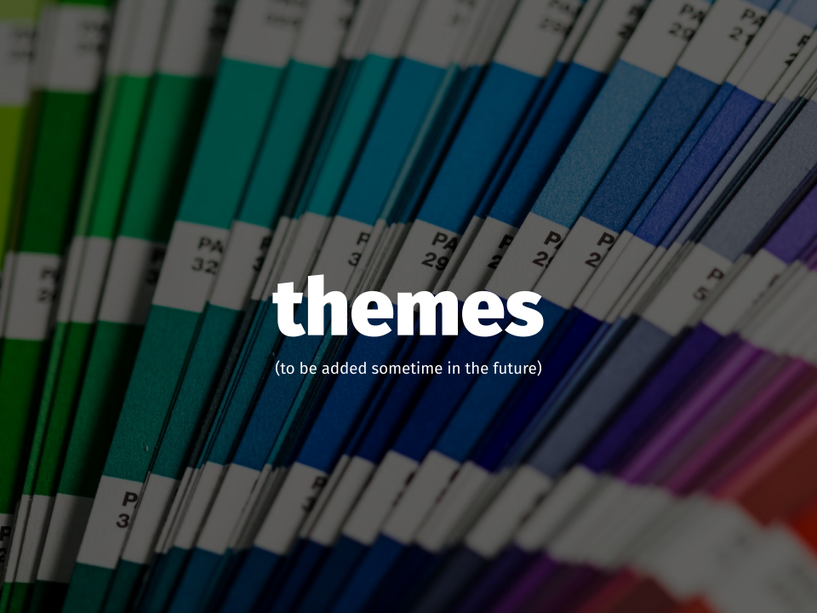
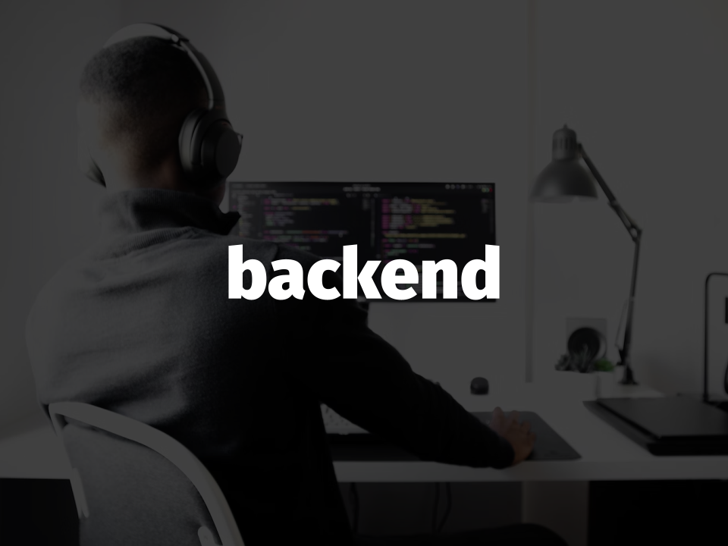
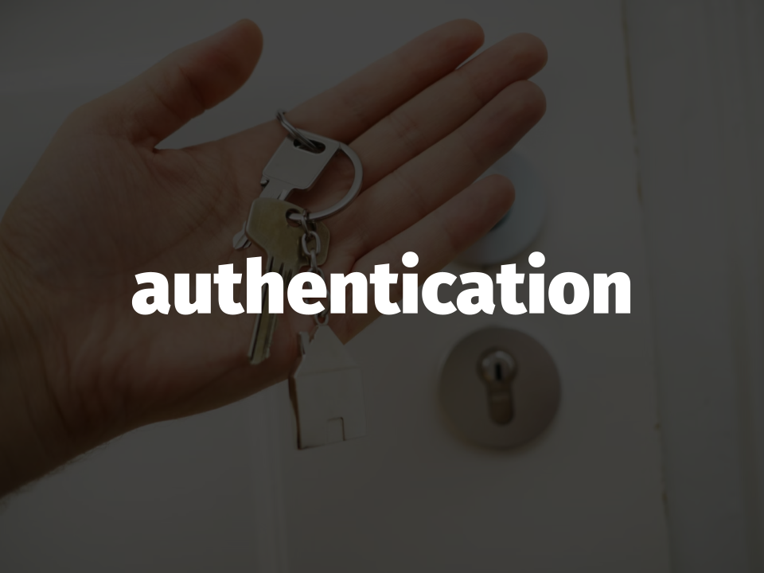
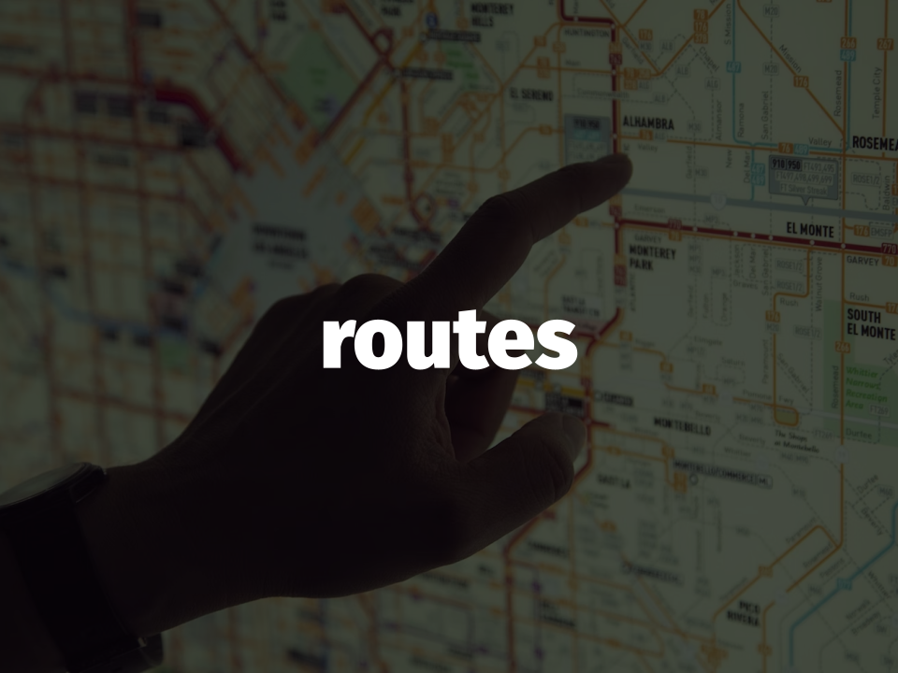
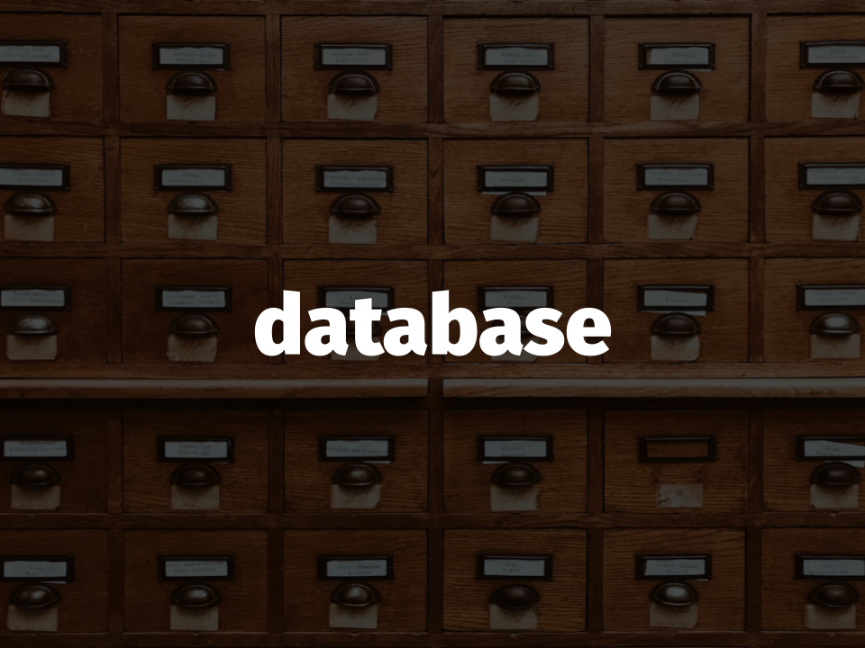

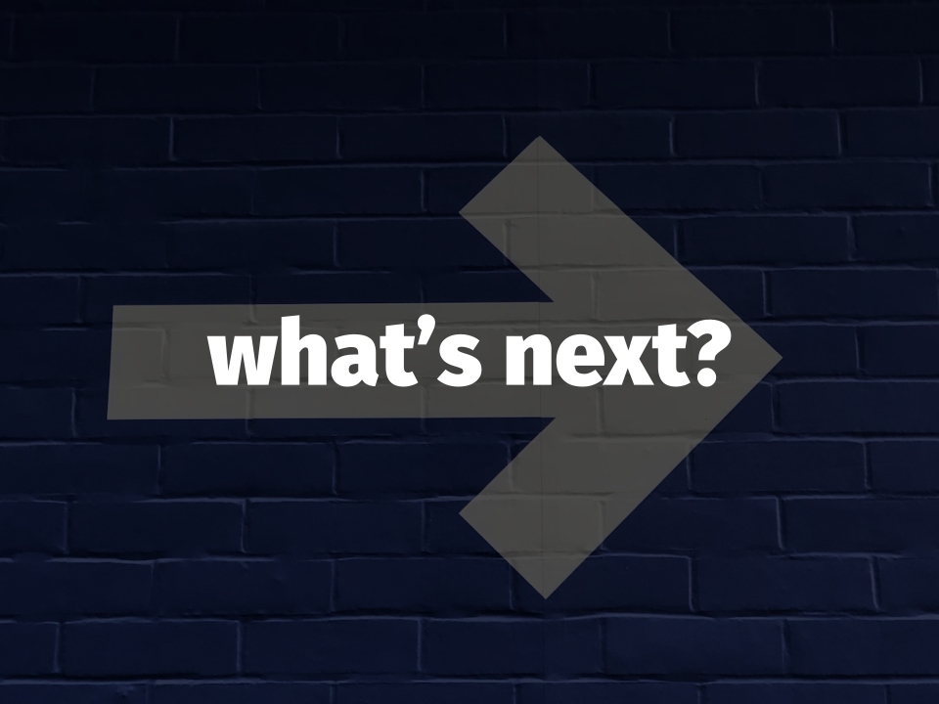
Thank you!
Dalle Rive Michele
d’Atri Sofia
De Filippo Loredana
Jeferson
Tafta Nicolò
See you at the next milestone!

